Slide 1

Welcome to Year 6!

Slide 2
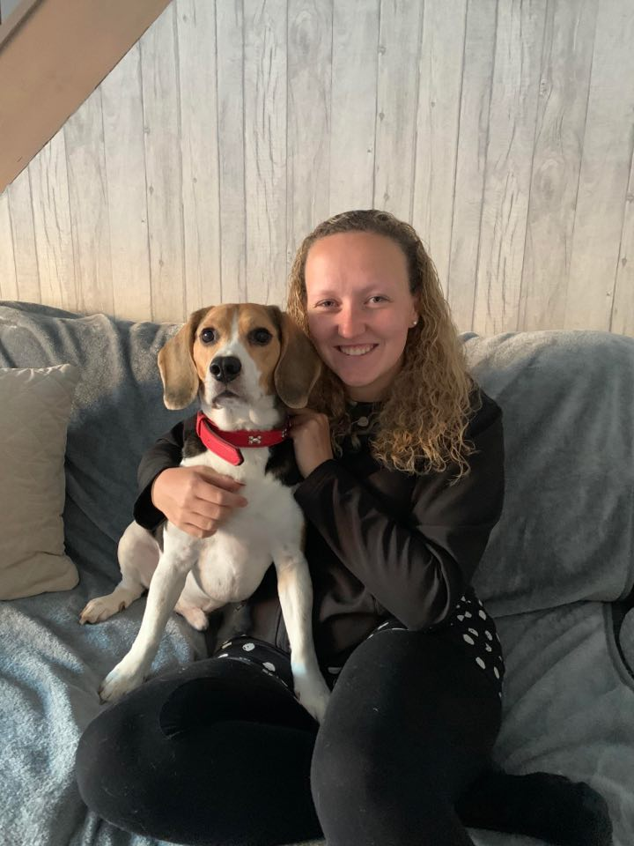
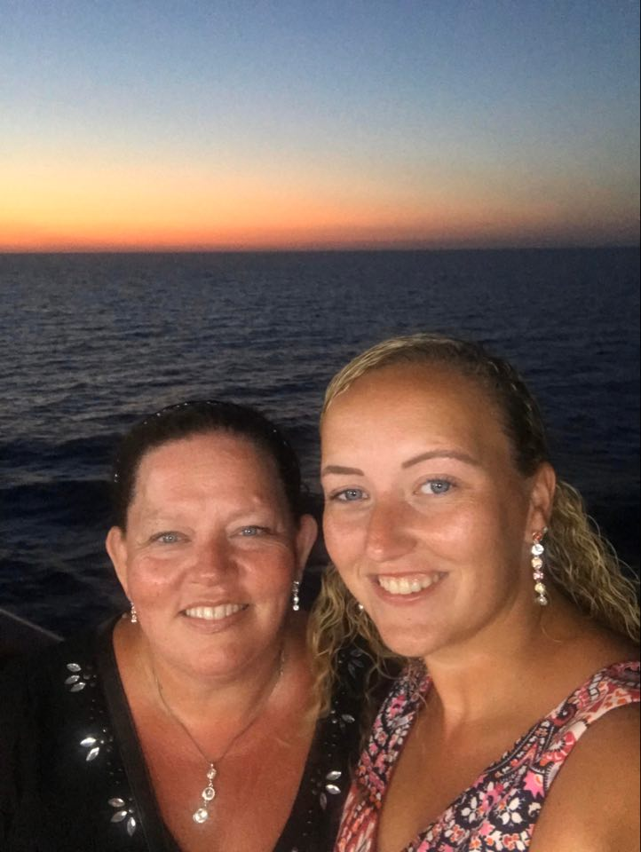
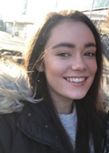

Who are the teaching staff?
The class teachers are Miss Booth and Miss Barrow
The year 6 Teaching Assistant is Mrs Booth.
During the teacher’s PPA time and SLT time, the children will be taught by Mrs Booth and Mr Parkinson.

Slide 3
Our themes for this year.
 | Autumn 1 | Autumn 2 | Spring 1 | Spring 2 | Summer 1 | Summer 2
English | Survival | Magic | Romeo & Juliet | Stormbreaker | Vikings | Transition
Science | Evolution & Inheritance | Light | The Circulatory System | Classification | - | Electricity
History & Geography | The World | The Kingdom of Benin | Vikings | Vikings | Robin Who? | Local Area Study
The Arts | Art: Camouflage Collage | Music: Djembe Drumming | Art: Carving Sculptures | D.T: Electrical Systems | D.T: Seasonal Meal | Music: Classroom Jazz

Slide 4
Arriving and Leaving School
Registration opens at 8.50am and closes at 9.10am.
Children in Year 6 should now enter school through the entrance in the car park of their building.
School finishes at 3.15pm and children should be collected from the same door.
In Year 6, children can walk home from school if it is ticked in their planner in September.
Any changes to home time collection arrangements must be notified by an adult to school staff and not via the child.

Slide 5
Uniform
Due to limited storage space, only reading book bags, lunch boxes and small drawstring bags are permitted.
School will provide all stationery.
The children should bring in a white t-shirt, black shorts and pumps or trainers in a drawstring bag for P.E. It is best to bring it into school on a Monday and take it home to be washed on a Friday, just in case we are able to have more sport sessions in the week.

Slide 6
Reading and School Planners.
The children will normally have a group guided reading session each week with a member of the teaching staff.
Individual readers are heard when possible by a member of staff or school helper, but the timetable is very busy and this cannot be guaranteed everyday, so daily reading at home is essential.
Their will be rewards in class for children who read regularly at home.
Any reading, no matter whether it is their school book, or their favourite superhero annual, should ideally be logged in their reading record in their planners.

Slide 7
Homework
1 piece of Maths and 1 piece of English homework will be given on a Thursday and is always based on current classroom learning.
Homework will need to be handed in on a Wednesday.
Help is available any day before hand-in-day.
Any homework not completed will be done during Wednesday lunchtime.
This is also given to help prepare the children for high school.

Slide 8
KS2 SATs
At present we do not know the date for when the KS2 tests will take place but they are usually during the first few weeks of May.
Spelling Test (20 questions)
Reading Test (60 mins)
Maths Arithmetic Test (30 mins)
Maths Reasoning Test 1 (40 mins)
Maths Reasoning Test 2 (40 mins)
We will complete SATs learning checks each half-term to prepare the children for the test routines.
While practice is essential, we endeavour to make it as light-hearted and fun as possible.

