Slide 1
Welcome to Year 3!

Slide 2
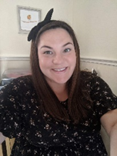
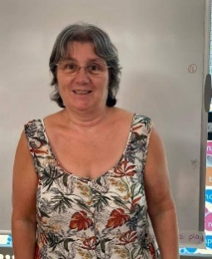
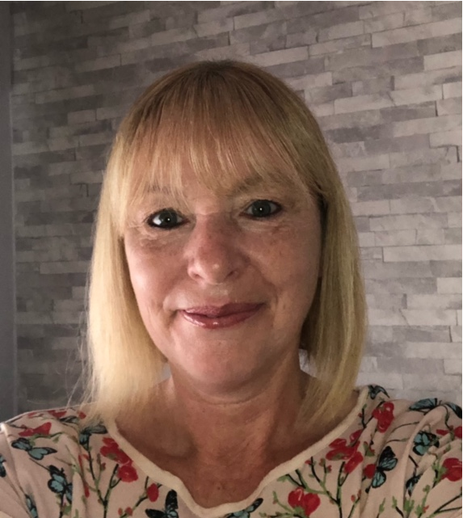
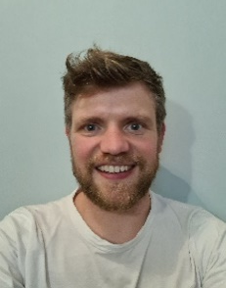

Who are the teaching staff?
The year 3 teaching staff are Mrs Holleran, Mr Charlton and the Teaching Assistants are Mrs Loughran and Mrs Newall.
On one afternoon each week, during the class teachers’ non-contact time, the children will be taught P.E. by Mr Parkinson.
Children in Year 3 will also receive specialist music tuition from MAPAS (Salford’s music service).

Slide 3
Our themes for this year.
 | Autumn 1 Rock and Roll | Autumn 2 The Iron Man | Spring 1 Light | Spring 2 What The Romans Did For Us | Summer 1 How Does Your Garden Grow | Summer 2 There’s No Place Like Home
Maths
English | Cave Baby How to Wash a Woolly Mammoth.(non-fiction) | The Iron Man Frank N Stan | Poetry and Play script | The Tunnel A Street Through Time (non-fiction) | the Rules of Summer Jack and The Baked Bean Stalk. | The Tin forest
Science | Rocks | Forces | Light | Plants | Plants | Animals including humans
History & Geography | History: Ancient Britain – Stone age to Iron age | Geography: Human + physical geography | History: Roman Britain | History: Roman Britain | Geography: Fieldwork study of the local area | Local Study History and Geography
The Arts | MAPAS Music | MAPAS Music | Cut, make and combine Mosaics - clay | MAPAS Music | Design Technology Food | Drawing and painting landscapes?

Slide 4
Arriving and Leaving School
Registration opens at 8.50am and closes at 9.10am.
Children in Maple One and Maple Two should enter and leave school through designated doors which will be signposted on the playground
School finishes at 3.15pm and Maple class children should be collected from the playground
Any changes to home time collection arrangements must be notified by an adult to school staff and not via the child.
.

Slide 5
P.E. – days, kit and other uniform.
The children should have the following kit: white t-shirt, black shorts and plimsolls. In addition, we would like the children to have tracksuit bottoms in winter. Ideally these would be plain blue or black bottoms.
Earrings – children should not wear earrings for P.E. Therefore, unless they are able to remove them themselves, they should not wear them on P.E. Days.
Children with hair longer than shoulder length should tie their hair back (this applies to boys as well as girls)
A reminder - hair accessories should be small, girls socks should be white or grey, and boys socks should be grey or black.

Slide 6
Reading and School Planners.
The children will normally have a group/ guided reading session each week with a member of the teaching staff
Individual readers are heard when possible by a member of staff or school helper but the timetable is very busy and sometimes this cannot be guaranteed, so daily reading at home is essential.
Any reading, no matter whether it is their school book, or their favourite superhero annual should ideally be logged in their reading record.
At their stage of development, it is important that the children are questioned on the book to ensure that they are understanding the text and discussing unfamiliar language.
Children will be given planners in which you should record when you have read with your child. You will also find useful school information in the planner and information about up coming events

Slide 7
Support.
If your child did not pass the phonics screening check in Y1 or Y2 she or he will continue to receive additional support with reading and spelling. This will not necessarily be phonic based learning as different teaching strategies may be more appropriate.
All work is differentiated to meet the needs of individual children through “personalised learning”.

Slide 8
Homework and homework books.
The children will be given spelling homework.
They may also be asked to practise times tables in preparation for the new test at the end of Y4.
Project books will also be sent home at the start of each half term.

Slide 9
Please note that during the current on going Covid -19 pandemic, school may need to change some of the arrangements described in this presentation to be in line with the current government guidance and to maintain the health and safety of all members of our school community.

