Slide 1
Welcome to Year One!

Slide 2
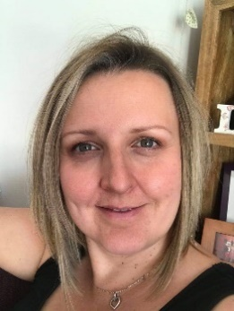
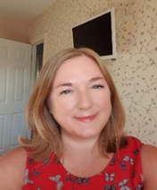
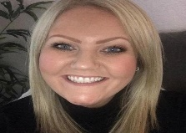


Who are the teaching staff?
The Year One teachers are Mrs Frost and Mrs Oliver.
The Year One’s TAs are Mrs Greaves and Mrs Oliver.
Once a week, the children will be taught P.E. by Mr Parkinson and Mr Bifle.
Mrs Frost leads phonics and will support Year One children prepare for the Phonics Screening at the end of the year.

Slide 3
Our themes for this year.
Y1 Curriculum
 | Autumn 1 | Autumn 2 | Spring 1 | Spring 2 | Summer 1 | Summer 2
Maths | Number: Place value and addition within 10. | Number: subtraction within 10. Geometry: Shape. | Number: Place value, addition and subtraction within 20. | Number: Place value within 50. Measurement: | Number: multiplication, division and fractions. Geometry: | Number: Place value within 100. Measurement: Money and time.
English | Meerkat Mail and Polar animals. | The Moon! | Toys! | Poems and Little Red Riding Hood | Jack and the beanstalk | The Three Little Pigs
Science | Animals including humans | Seasonal Changes | Animals including | Seasonal Changes | Plants | Everyday materials
History/Geography | Geography: The location of hot and cold areas of the world | History: The history of a famous person (Neil Armstrong) | History:. How toys have changed. | Geography: Locational knowledge Seasonal changes | Geography: Simple geographical skills and fieldwork | Local Study: ( History and Geography)
Art/DT/Music | Music: The King of All Polar Bears | Art: Space collage using different materials | Design Technology: making a moving vehicle | Music: Round and Round | Art: Sketching and painting landscapes | DT: Food Planning and making

Slide 4
Arriving and Leaving School
Registration opens at 8.50am and closes at 9.10am.
Children in Ash class should enter and leave school through the Nursery door.
School finishes at 3.15pm and Ash class children should be collected from the Nursery door.
Any changes to home time collection arrangements must be notified by an adult to school staff and not via the child.

Slide 5
Break and Lunch Times
All children will receive toast at snack time
Milk is also available if you wish to pay for this
All children can drink from their water bottles at any time of the day (except during direct teaching!)
Children in Y1 receive a piece of fruit after lunch break
School lunches are free for children in KS1
Children may bring in packed lunches if they prefer
Children in Y1 will all have lunch and break together

Slide 6
Expectations
Children will be supported with the transition from Early Years teaching methods to a more formal learning style
Children will move to working in exercise books
Children will still have lots of practical learning opportunities
The class rooms will have a roleplay area, a reading corner plus provision areas such as a fine motor skills area
When and where possible, learning will be enhanced by visits, trips and workshops

Slide 7
P.E. kit.
Physical Education will be taught at least once a week
The children should have the following kit: white t-shirt, black shorts and plimsolls. In addition, we would like the children to have black tracksuit bottoms in winter
Children should come into school in their PE kit on the day that their class does PE. You will be informed via a text message which day this is
Earrings – children should not wear earrings for P.E. Therefore, unless they are able to remove them themselves, they should not wear them on P.E. Days
Children with hair longer than shoulder length should tie their hair back (this applies to boys as well as girls)
A reminder - hair accessories should be small, girls socks should be white or grey, and boys socks should be grey or black

Slide 8
Reading and School Planners.
The children will normally have a group/guided reading session each week, with
a member of the teaching staff
Individual readers are heard when possible by a member of staff or school helper but sometimes the timetable is very busy and this cannot be guaranteed, thus daily reading at home is essential
Any reading, no matter whether it is their school book, or their favourite superheroes annual should ideally be logged in their school planner
It is important that the children are questioned on the book to ensure that they are understanding the text and discussing unfamiliar language
Children will be given planners in which you should record when you have read with your child. You will also find useful school information in the planner and information about up coming events

Slide 9
Homework
Project books will also be sent home at the start of each half term
Some children may bring phonics packs home to practice near to the phonics screening test
The children may be given a homework spelling book

Slide 10
Phonics Screening Check
Children in Y1 throughout the country will normally take part in a phonics screening check during the month of June. Head teachers should decide whether it is appropriate for each child to take the phonics screening check and school will discuss this with you nearer the time.
The Phonics screening check is designed to confirm whether children have learnt sufficient phonic decoding and blending skills to an appropriate standard. If your child does not reach this required standard, they will continue to be taught phonics and will have the chance to take part in the phonics screening check again at the end of Y2.

Slide 11
What Happens During The Test
The test contains 40 words
Each child will sit one to one and read each work aloud to a teacher
The test will take approximately 10 minutes per child; although all children are different and will complete the check at their own pace
The list of words the children read is combination of 20 real words and 20 pseudo words (nonsense words)

Slide 12
Please note that during the current on going Covid -19 pandemic, school may need to change some of the arrangements described in this presentation to be in line with the current government guidance and to maintain the health and safety of all members of our school community.

