Slide 1
Welcome to Year One!

Slide 2
Who are the teaching staff?
The Year One teacher is Miss Fordham
The Year One TA is Mrs Greaves.
Once a week, during the class teachers’ non-contact time, the children will be taught P.E. by Mr Parkinson.
Mrs Frost leads phonics and will support Year One children prepare for the Phonics Screening at the end of the year.

Slide 3
The School Day
The school day for Y1 runs as follows:
9:10am -9:30am Assembly
9:30am-10:00am Phonics
10:00am – 10:40am English or Maths
10:40am-11:00am Break
11:00am-11:15am Milk and Toast
11:15am-12:00pm English and Maths
12:00pm-1:00pm Lunch
1:00pm-1.15pm Shared reading
1.15pm – 1.45pm Guided Reading
1.45pm-3.15pm Topic

Slide 4
Break Times
All children will receive toast at snack time
Milk is also available if you wish to pay for this
All children can drink from their water bottles at any time of the day ( except during direct teaching!)
Children in Y1 and Y2 receive a piece of fruit after lunch break
School lunches are free for children in KS1
Children may bring in packed lunches if they prefer

Slide 5
Our themes for this year.

Slide 6
Expectations
Children will be supported with the transition from Early Years teaching methods to a more formal learning style.
Children will work in exercise books.
Children will still have lots of practical learning opportunities.
The class room will have a roleplay area, a reading corner plus provision areas such as a fine motor skills area.

Slide 7
P.E. kit.
Physical Education will be taught at least once a week.
The children should have the following kit: white t-shirt, black shorts and plimsolls. In addition, we would like the children to have tracksuit bottoms in winter. Ideally these would be a black tracksuit.
Kit should be brought into school at the start of each half term and will be then be sent home at the end of the half term.
Please send PE kit into school in a draw string bag ( not a back pack) so that it can be hung on the coat pegs easily.
Earrings – children should not wear earrings for P.E. Therefore, unless they are able to remove them themselves, they should not wear them on P.E. Days.
Children with hair longer than shoulder length should tie their hair back (this applies to boys as well as girls)
A reminder - hair accessories should be small, girls socks should be white or grey, and boys socks should be grey or black.

Slide 8
Reading and Reading Records.
The children will normally have a group/ guided reading session each week, with a member of the teaching staff.
Individual readers are heard when possible by a member of staff or school helper but the timetable is very busy and this cannot be guaranteed, thus daily reading at home is essential.
Any reading, no matter whether it is their school book, or their favourite superheroes annual should ideally be logged in their school planner.
It is important that the children are questioned on the book to ensure that they are understanding the text and discussing unfamiliar language.
Children will be given planners in which you should record when you have read with your child. You will also find useful school information in the planner and information about up coming events.

Slide 9
Homework
The children will be given a homework spelling book.
Project books will also be sent home at the start of each half term.
Some children may bring phonics packs home to practice near to the phonics screening test.

Slide 10
Arriving and Leaving School
Registration opens at 8.50am and closes at 9.00 am.
Assembly starts at 9.00 am so it is essential that your child arrives promptly for school.
Children in Y1 should line up in-front of the Y2 class windows.
School finishes at 3.15pm and children should be collected from outside the Nursery side door in the infant playground.

Slide 11


Slide 12
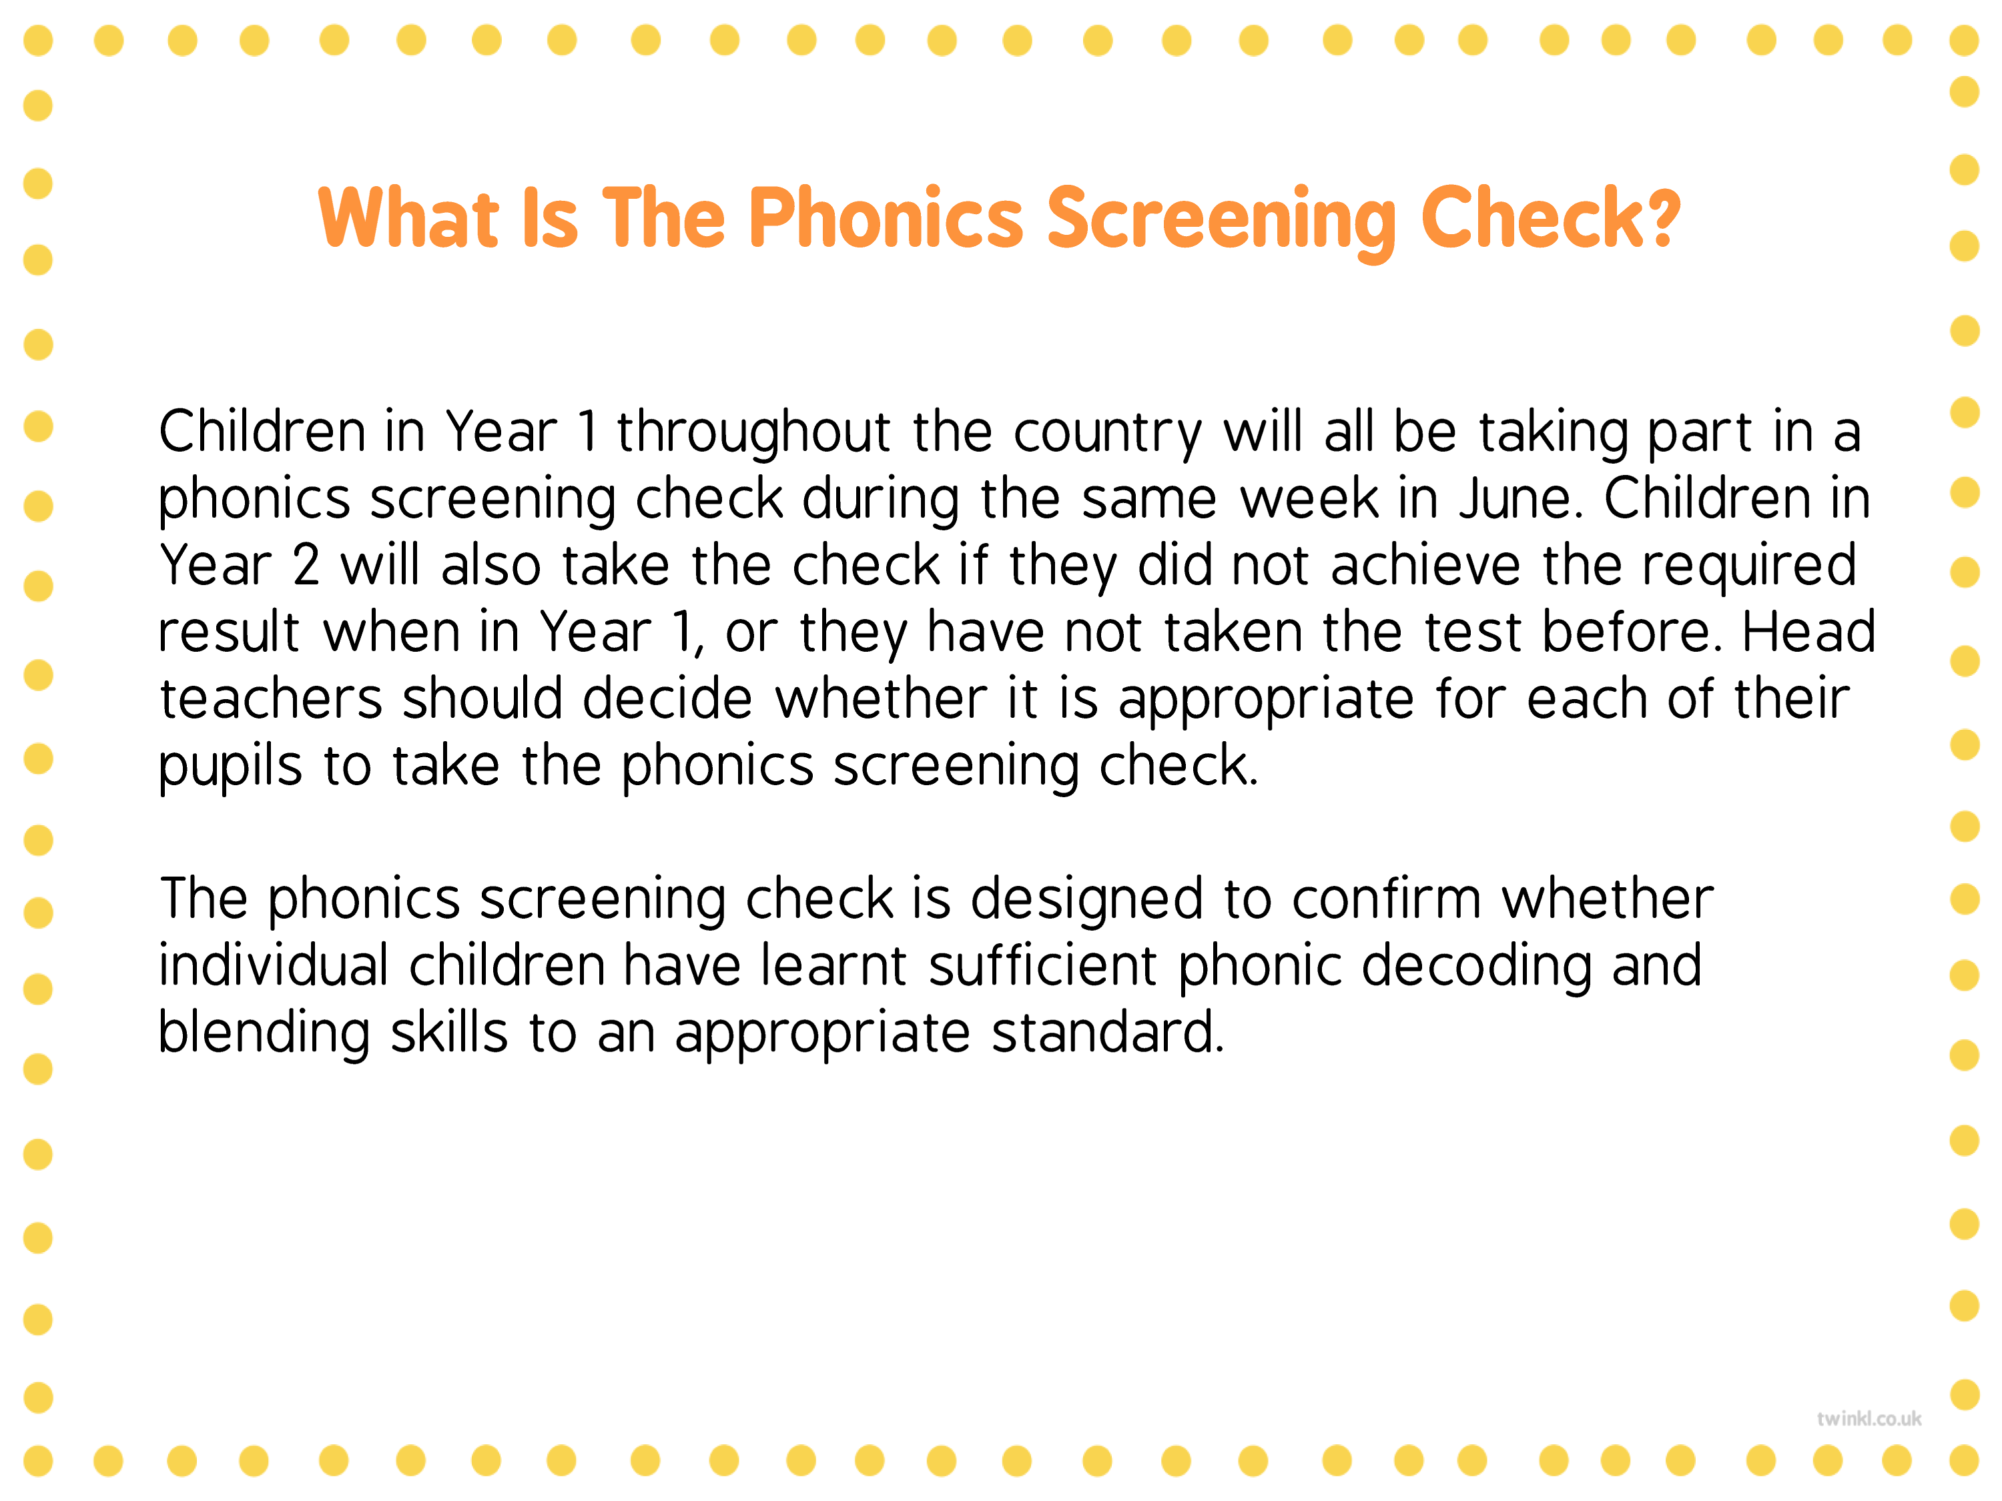

Slide 13
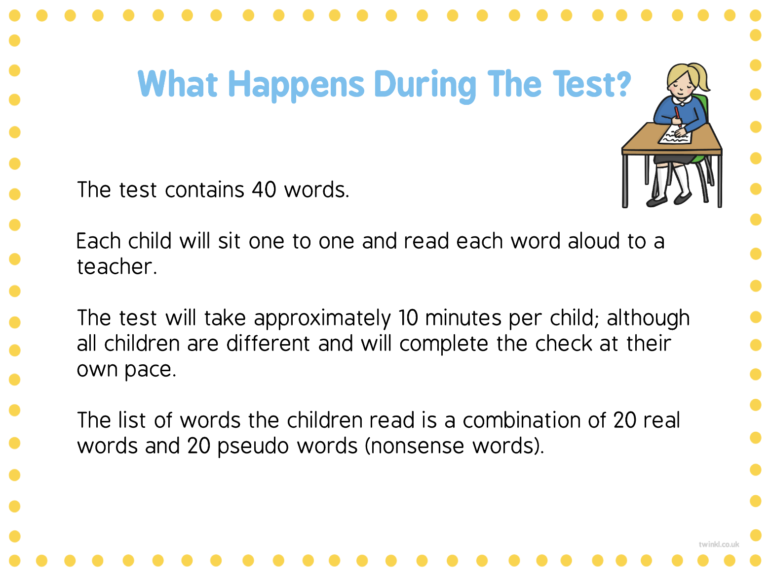

Slide 14
Any questions?

