Slide 1
Welcome to Year 2!

Slide 2
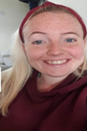
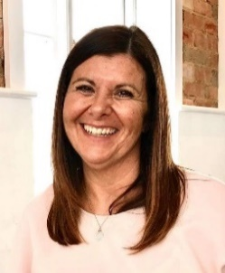
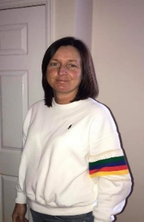
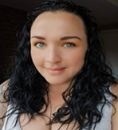

Who are the teaching staff?
The year 2 teachers are Mrs Oliver and Miss Sykes
The year 2 Teaching assistants are Mrs Liptrot and Miss Hattersley.
On one afternoon, during the class teachers’ non-contact time, the children will be taught P.E. by Mr Parkinson

Slide 3
Our themes for this year.
Y2 Curriculum
 | Autumn 1 The Place Where I Live | Autumn 2 The Queen | Spring 1 Where would you prefer to live, Kenya or Walkden? | Spring 2 Fire! Fire! | Summer 1 Under the Sea | Summer 2 Buckets and Spades
Maths | Number: Place value and addition and subtraction | Measurement: Money Number: multiplication and division | Number: multiplication and division Statistics Geometry: shape | Number: Fractions Measurement: length and height. | Geometry: position and directions. Problem solving and efficient methods Measurement: time | Measurement: Mass, capacity and temperature
English | Writing Outcome: Stuck and Ruby’s School Walk | Writing Outcome: The Queens Knickers The Queen’s hat The Queen (non-fiction) | Outcome: Bringing the rain to the Kapiti Plain (poem) Anansi the Spider | Writing Outcome: : Fire(poem) The Great Fire Of London | Writing Outcome: Sea poems Seaside Creatures (non-fiction). | Writing Outcomes: Harry and the Jaggedy Daggers
Science | Everyday materials | Everyday materials | All living things & their habitats | Animals including humans | Plants
History/Geography | Geography:-.a study of the local area. | History: Queen Elizabeth 11 | Geography: contrasting Walkden with Kenya | History:The Great Fire of London | Geography:seaside locations. | Local Study ( Geography and History)
Art/DT/Music | Art: Lowry | Design Technology: - Food Art: Appreciate portraits of the Queen | Music: Zootime Art: Appreciate African masks and art | Design Technology: design and create Wheeled vehicle Art: Appreciate paintings of the great fire of London | Music: Journey ~ Art: Appreciate Sea Scapes | Art: Printing techniques –

Slide 4
Arriving and Leaving School
Registration opens at 8.50am and closes at 9.10am.
Children in Willow 1 and Willow 2 should enter and leave school through the Y2 door on the playground
School finishes at 3.15pm and Willow class children should be collected from the same Y2 door.
Any changes to home time collection arrangements must be notified by an adult to school staff and not via the child.

Slide 5
Lunch and Snack times
All children will receive toast at snack time
Milk is also available if you wish to pay for this
All children can drink from their water bottles at any time of the day (except during direct teaching!)
Children in Y2 receive a piece of fruit after lunch break
School lunches are free for children in KS1
Children may bring in packed lunches if they prefer
Children in Y2 will all have lunch and break together

Slide 6
P.E. – days and kit and other uniform.
Physical education will be taught teach week
The children should have the following kit: white t-shirt, black shorts and plimsolls. In addition, we would like the children to have tracksuit bottoms in winter. Ideally these would be plain blue or black bottoms
Children should come into school in their PE kit on the day that their class does PE. You will be informed via a text message which day this is
Earrings – children should not wear earrings for P.E. Therefore, unless they are able to remove them themselves, they should not wear them on P.E. Days
Children with hair longer than shoulder length should tie their hair back (this applies to boys as well as girls)
A reminder - hair accessories should be small, girls socks should be white or grey, and boys socks should be grey or black

Slide 7
Reading, School Planners and Phonics
The children will normally have a group/ guided reading session each week, with a member of the teaching staff
Individual readers are heard when possible by a member of staff or school helper but sometimes the timetable is very busy and this cannot be guaranteed, thus daily reading at home is essential
Any reading, no matter whether it is their school book, or their favourite superheroes annual should ideally be logged in their planner
At their stage of development, it is important that the children are questioned on the book to ensure that they are understanding the text and discussing unfamiliar language
Children who did not pass phonics screening in Y1 will continue to work on learning and using phonics as a means to improve their reading and will re-sit the check at the end of Y2
Children will be given planners in which you should record when you have read with your child. You will also find useful school information in the planner and information about up coming events

Slide 8
Homework and Homework books.
The children will be given a homework spelling book
They may also be asked to practise times tables
Project books will also be sent home at the start of each half term

Slide 9
Arriving and Leaving School
Registration opens at 8.50am and closes at 9.00 am
Phonics teaching starts at 9.00 am so it is essential that your child arrives promptly for school
Children in Y2 should line up at the bottom of the ramp into school in the big playground
School finishes at 3.15pm and children should be collected from the same place

Slide 10
KS1 Assessments
At the end of Year 2, children will take assessments in Reading and Maths. The tests take place towards the end of May each year.
There are 4 papers:
Reading paper 1
Reading Paper 2
Maths Arithmetic Test
Maths Reasoning Paper
Some children may also take part in the Phonics Screening Check if they did not meet the expected standard or did not sit the check in Y1.
We will complete learning checks each term to prepare the children for the test routines.
While practice is essential, we endeavour to make it as light-hearted and fun as possible.

Slide 11
How Can You Help?
First and foremost, support and reassure your child that there is nothing to worry about and that they should always just try their best. Praise and encourage!
Ensure your child has the best possible attendance at school.
Support your child with any homework tasks.
Reading, spelling and arithmetic (e.g. times tables) are always good to practise.
Talk to your child about what they have learnt at school and what book(s) they are reading (the character, the plot, their opinion).
Make sure your child has a good sleep and a healthy breakfast every morning!
Please ensure that your child attends school in May!

Slide 12
Please note that during the current on going Covid -19 pandemic, school may need to change some of the arrangements described in this presentation to be in line with the current government guidance and to maintain the health and safety of all members of our school community.

