Slide 1
This meeting is about the process of learning to read and how we teach the skill of Reading at St Paul’s.

Slide 2




How many times have you already read today?
Notes:
Slide purpose:
To help parents see the value of reading by getting them to reflect on their own reading experiences
Suggested script:
Just think about how many times you have already read things today. More than ever, we are surrounded by text and reading is a vital skill.
We want all of our children to become confident readers who can navigate the world of reading around them.

Slide 3
What is reading?
Reading is the ability to decode and interpret a written word.

Slide 4
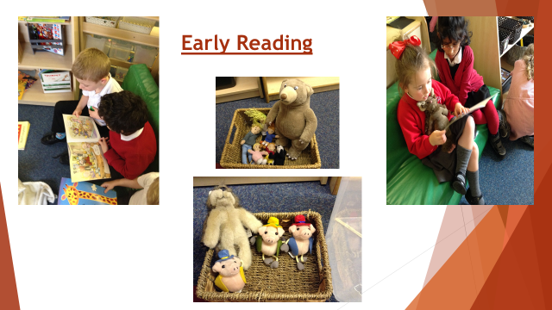

Slide 5
Learning to read can be hard!
• So often it is hard to understand why a child reads ‘they’ on one page and can’t remember it on the next.
• Early reading is a combination of: – using phonics, reading words that they know, working out the context from the pictures and the story– and lots of help from us.
• As their knowledge of letter sounds and sight vocabulary increases, they begin to read more independently

Slide 6
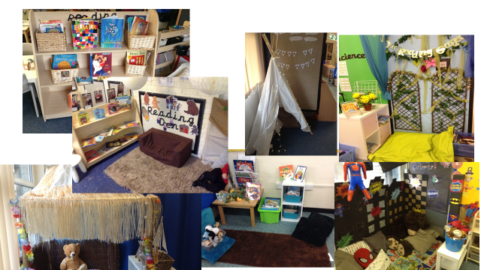
Love Of Reading!

Slide 7
How we teach Reading at St Paul’s
Discreet Phonics lessons to teach letter sounds and key words.
Reading practice sessions.
Reading interventions where needed.
Shared Reading.
Developing a love of reading.

Slide 8
How do we teach letter sounds?
We teach the sounds represented by letters – this is called ‘phonic knowledge’.
We use an approach based on Little Wandle: Letters and Sounds.

Slide 9
Foundation of phonics: Listening skills, rhyme, body percussion.
Phase 2: Introducing sounds, learning to blend
Phase 3: More sounds including digraphs, blending slightly longer words.
Phase 4 - Consolidation

Slide 10
Some words have to be learnt on sight because the children don’t have the advanced sound knowledge they need to work it out. We call these words ‘tricky words’ or ‘common exception.’
eg: house, said, they, was

Slide 11


We teach Phase 2 in this order
Notes:
Slide purpose:
To provide an overview of the Phase 2 sounds
Suggested script:
We usually teach four new sounds a week and have a review lesson on a Friday.
You will get a list of the sounds that we are learning to have at home. This will help you with letter formation (handwriting) and pronunciation.
Give the Phase 2 grapheme information sheet for Autumn 1 to parents.

Slide 12

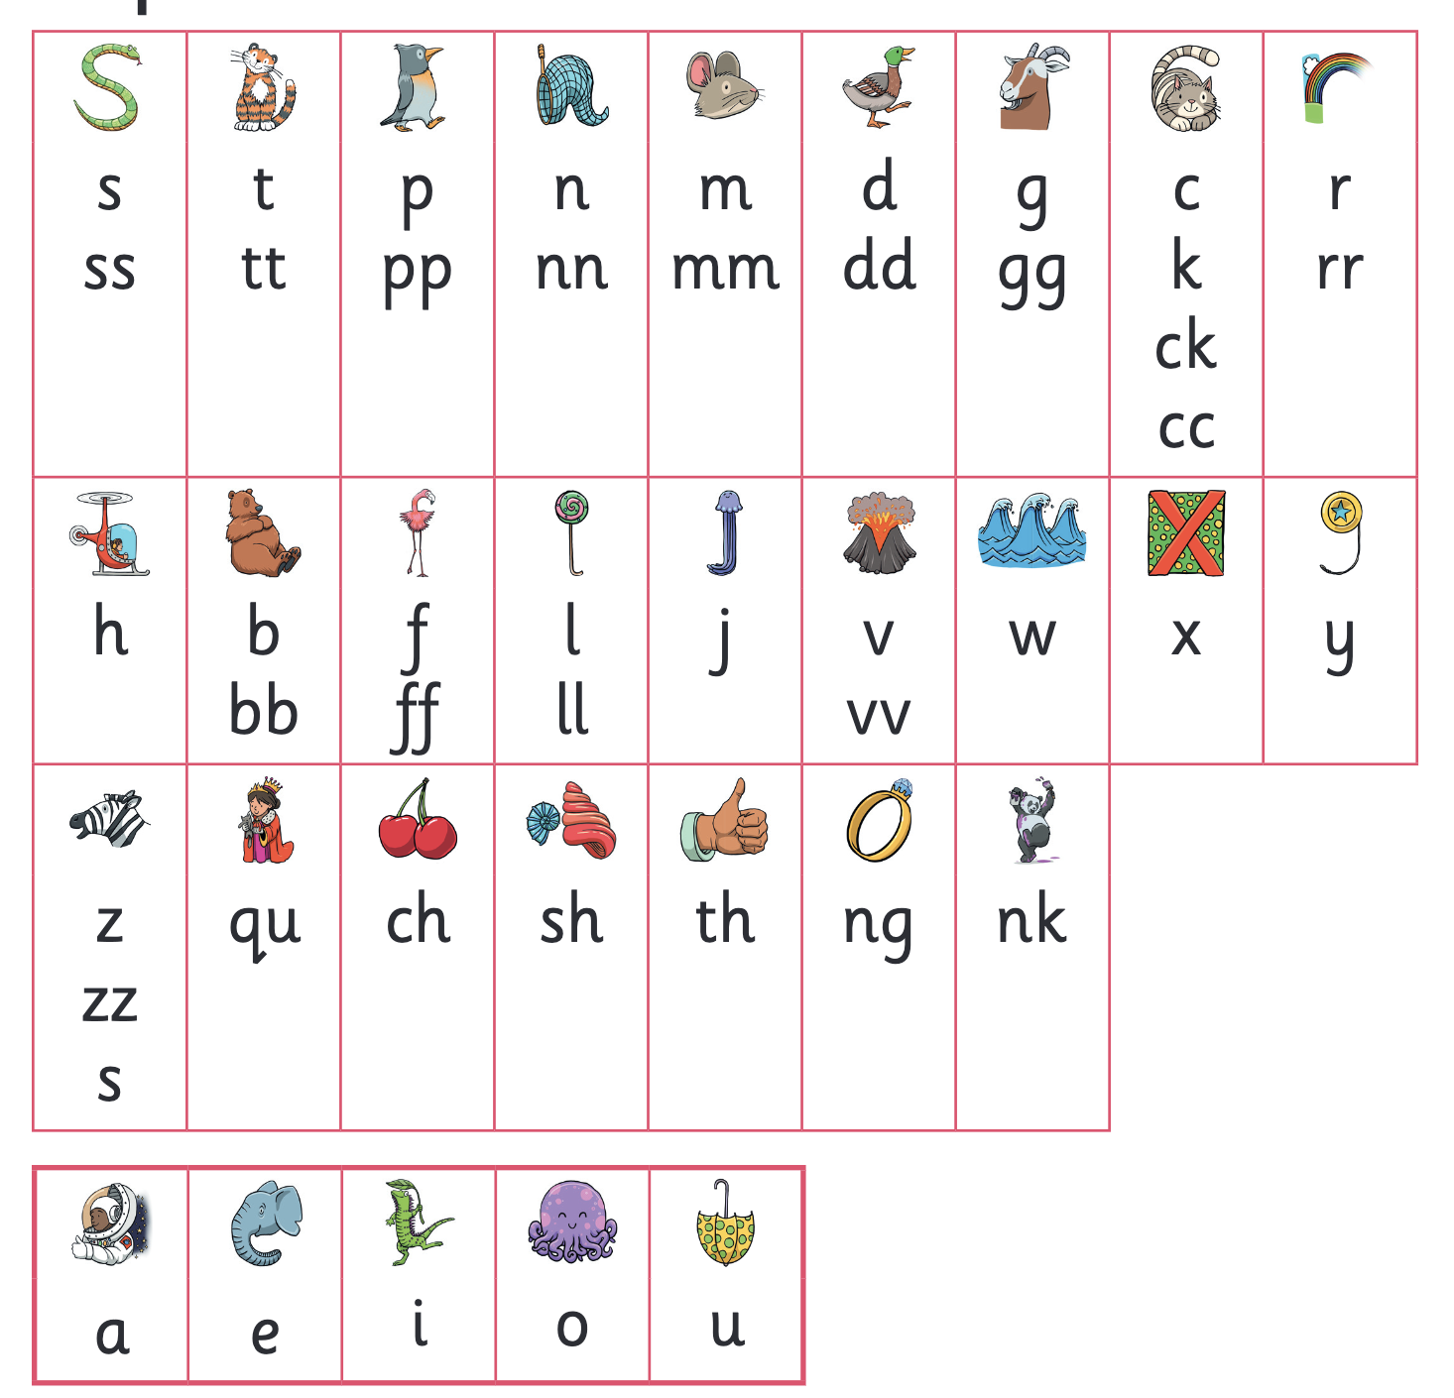
Let’s say the Phase 2 sounds
Notes:
Slide purpose:
To practise the Phase 2 sounds
Notes
Give out the parent handout and the Phase 2 and 3 grapheme mat.
Play the videos/teach the parents to say the Phase 2 sounds: https://www.littlewandlelettersandsounds.org.uk/resources/for-parents/
Show parents where to access these videos in the ‘For parents’ area of the Little Wandle website.

Slide 13
Applying Phonics in Reading
Blending : Putting the sounds together to read a word such as c/a/t. Children need to be able to read and say the separate sounds in a word and then blend them together to say the whole word.
A note about spelling
Segmenting is breaking up a word into its sounds such as dog d/o/g. Children need to be able to hear a whole word and say every sound that they hear to be able to spell it.

Slide 14






How we make learning stick
Notes:
Slide purpose:
To provide an overview of the programme’s efficacy
Suggested script:
There are specific resources for the Little Wandle Programme which the children will be very familiar with.
Each sound that we teach to begin with has either a mnemonic (like the astronaut that you can see here) or a phrase like boing-boing for ‘oi’. This helps the children recognise and remember the graphemes.
Every time we teach a new sound, we also read words during the phonics lesson that contain that new sound so that the children practise what they have learned.
We then go on to reading a sentence containing some of those words.
We have displays in the classroom and on the tables to support the children throughout the day.

Slide 15
Supporting your child with phonics
Notes:
Slide purpose:
To give guidance on supporting phonics learning at home
Suggested script:
It is really important that you pronounce the sounds correctly at home if you are supporting your child.
Use the videos we saw earlier for support.

Slide 16
Individual Reading
Once children are ready, they will receive a reading book.
Reading books are grouped according to the level of challenge.
Each group of books is matched to the phonic’s learning.
Children will move through the book levels as assessed by the teaching staff and matched to their current phonic’s learning.
The books will usually provide challenge but should not be too difficult so that your child should be able to read 90% of the words easily to help build confidence and automaticity.

Slide 17
Reading In School and at home
Children will read their reading book in a small group with an adult in school.
Once your child has read the book 3 times in school it will be sent home to practice further.
Please record the title of their new book on the Learrning with Parents website were you can also make comments on how they have read at home or share a photo or video of your child reading.
When your child has read at home 3 times, they will receive a reading reward.
Your child will also be given a book to share with an adult from the class library which should be read to them at home.

Slide 18
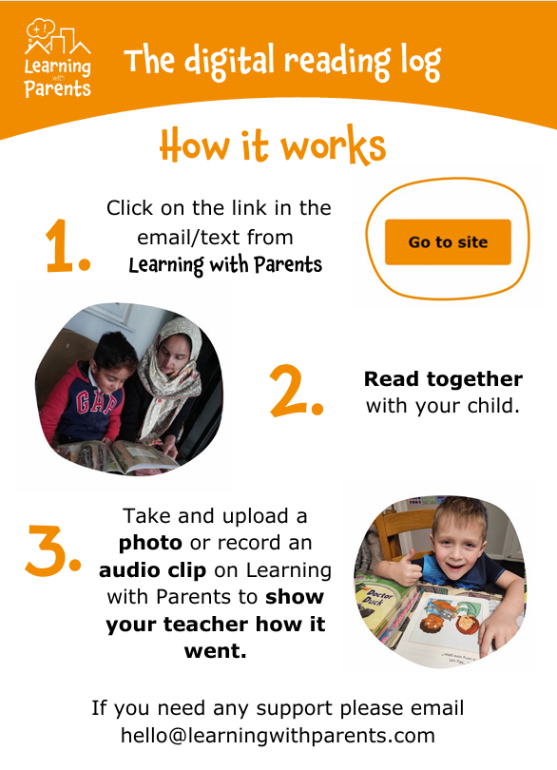
Learning with Parents
Parent Introduction to the Reading Log (video) - Learning with Parents

Slide 19
Practice Reading Sessions
Reading sessions are held 3 times a week and are used to explicitly teach children how to read.
Children will read a book together in a group with an adult.
This will take place 3 times a week focussing first on decoding, then prosody (developing reading with appropriate meaning, stress and intonation. It provides an opportunity to explore characters’ feelings, what words mean and how punctuation adds to the meaning) then finally comprehension which involves answering questions about the text.
The adult will check in with each child during reading to check that they are reading accurately and reading with correct intonation by noticing punctuation.
As a group they will answer questions about the book to develop their understanding and comprehension skills.

Slide 20
Shared Reading
Each day, the children will listen to and share a quality book during story times. These books have been chosen to enhance the topics that children are working on but also to introduce vocabulary and ensure that the children hear well constructed sentences.

Slide 21
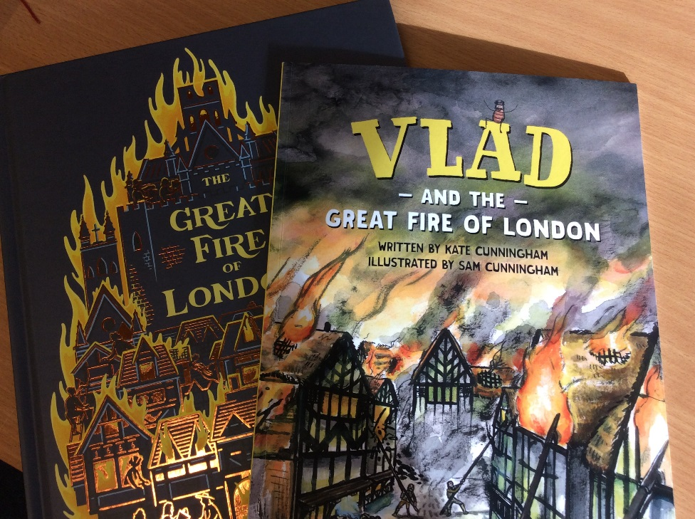
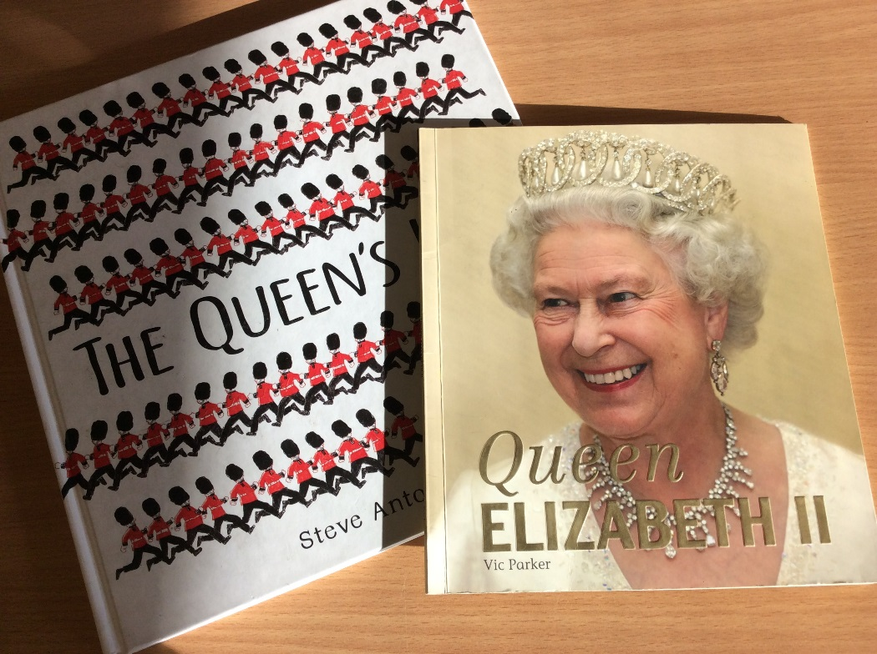
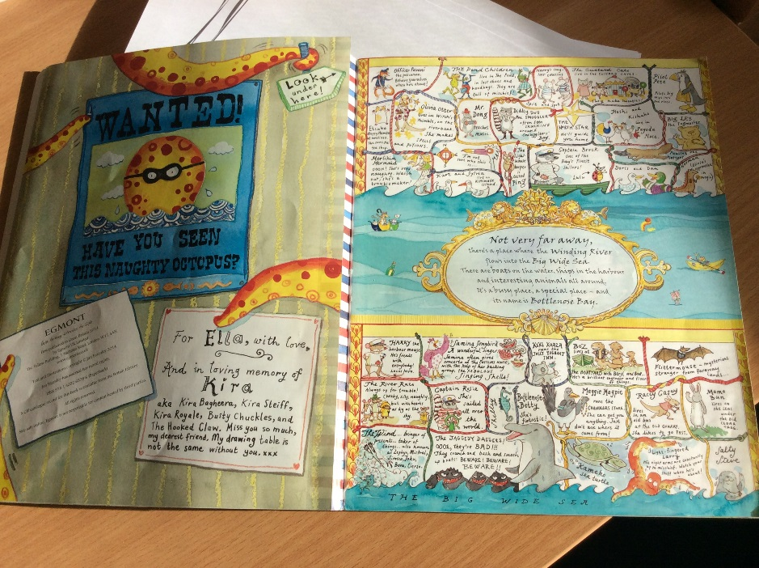
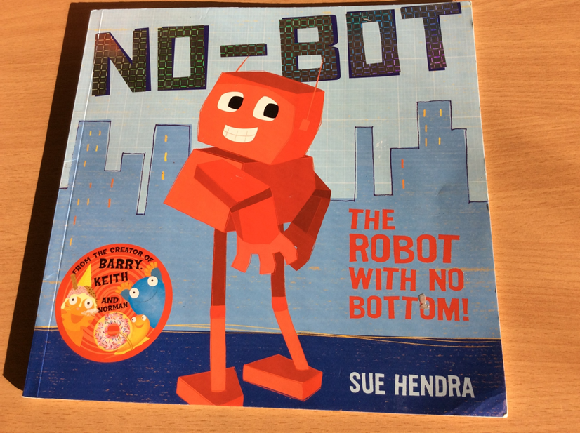
High-quality Texts – KS1
Notes:
English writing taught from high quality text starting point
In conjunction with Simply Books
Fiction and Non Fiction
Also topic books of quality
Texts linked to topics spent 2 years developing a text based curriculum

Slide 22
How to Help your Child Learn to Read
It is the school’s role to teach reading. However, parents/carers play a vital role, too. It is important that children have plenty of practice reading at home in order to become fluent, confident readers.
Frequent, happy reading sessions at home, daily if possible are much better than infrequent, long and stressful ones.
It does not have to be a different book every time; it may need to be the same book if the child still needs to develop fluency.
The parent/carer’s role is to listen with interest and, most importantly, to encourage and praise, enthusiastically acknowledging the child’s achievement (even if, at the early stages, this is only small). After the child has read the book, it may be helpful to talk about the book, but only so far as the child is interested. This should be a positive experience; avoid turning it into a test.

Slide 23
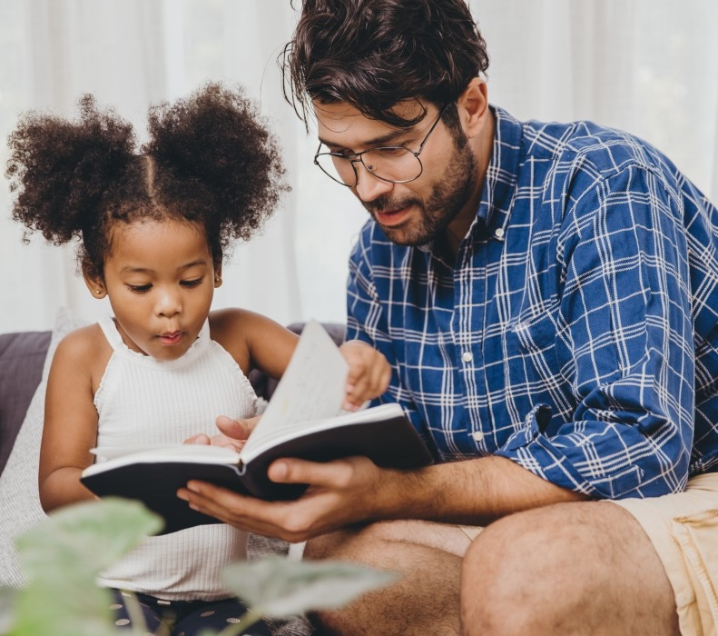
The most important thing you can do is read with your child
Reading a book and chatting had a positive impact a year later on children’s ability to…
understand words and sentences
use a wide range of vocabulary
develop listening comprehension skills.
The amount of books children were exposed to by age 6 was a positive predictor of their reading ability two years later.
Parental involvement in the development of children’s reading skills: A five-year longitudinal study (2002) Senechal, M. and Lefvre, J
Notes:
Slide purpose:
To summarise key takeaways
Suggested script:
Celebrate your child’s success at school.
Make time for reading at home!

Slide 24
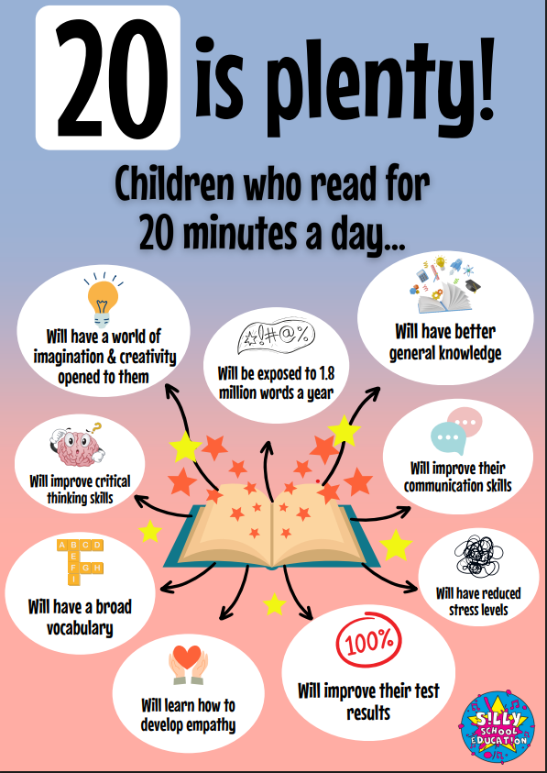

Slide 25
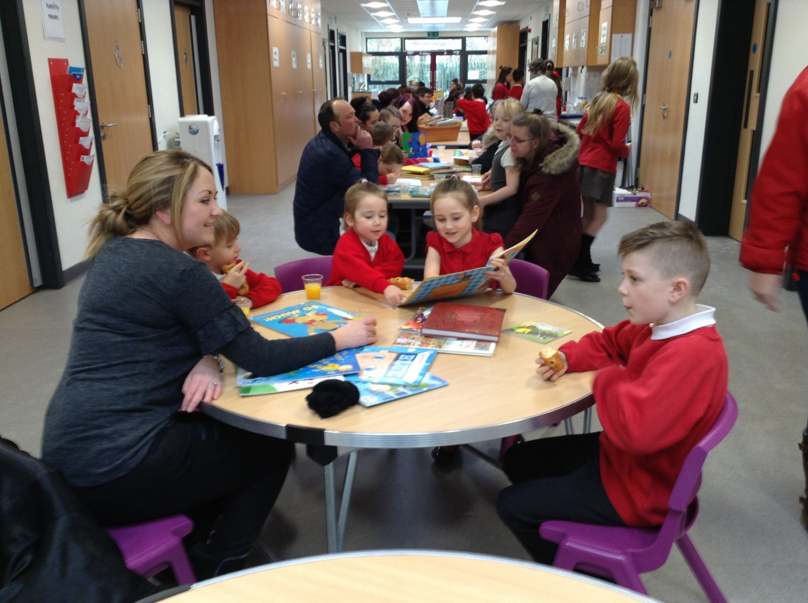
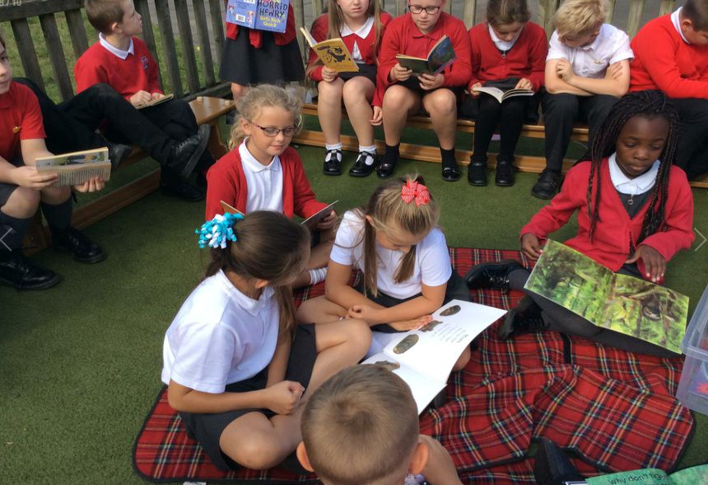
Whole School Reading Events
Notes:
Regular reading breakfast / cafes
Parents invited

Slide 26
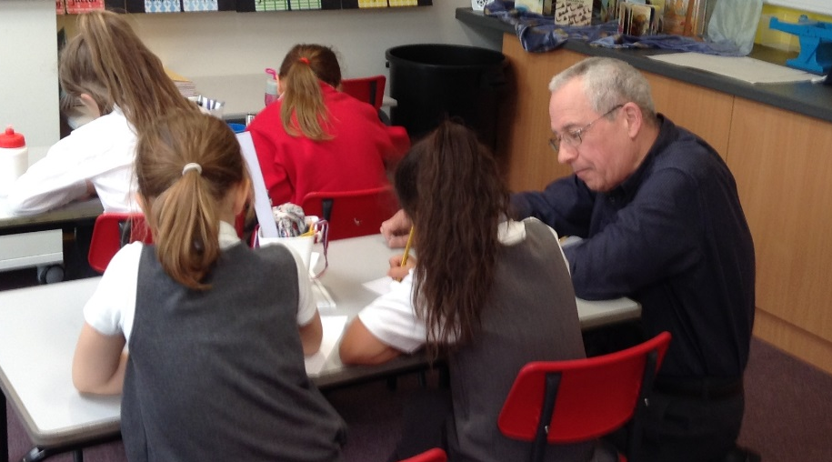
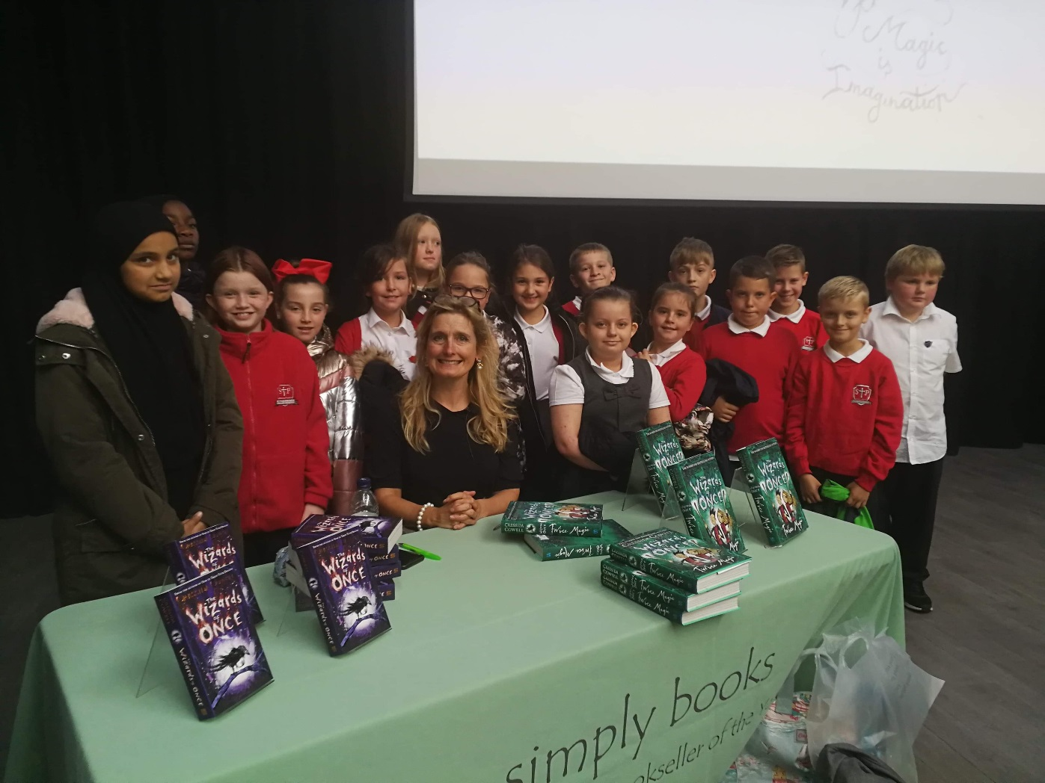
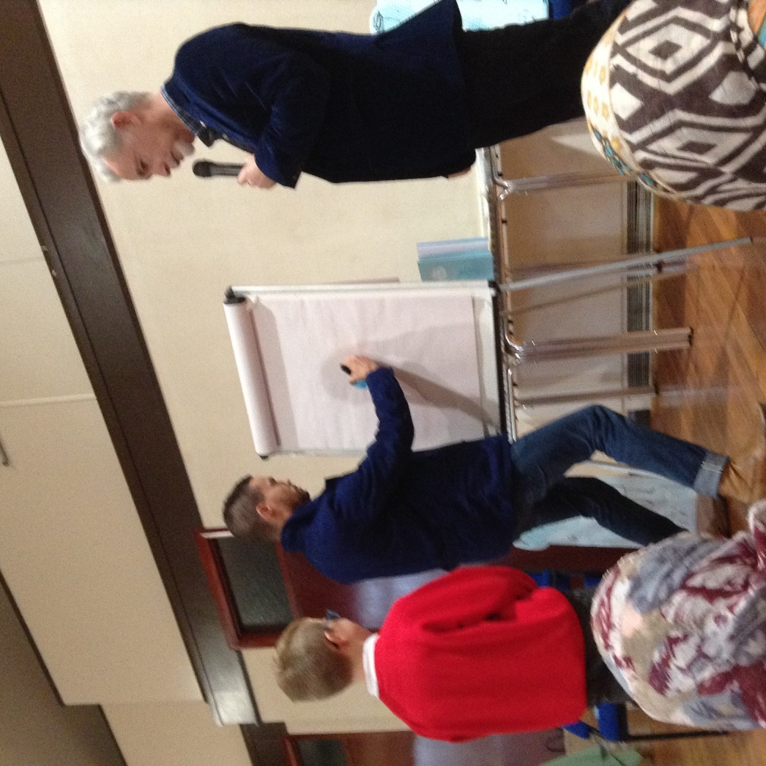
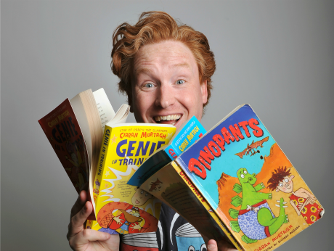
Author Visits
Notes:
Through links with Simply Books we have been to readings with Michael M, Cressida C, Eoin Colfer and Oliver Jeffers. Funded through PP each child got a signed copy of book to take home.
Also Kiaran M came into school for the whole day and we had a poet called Andy Toole into school to help the children write their own poems.

Slide 27
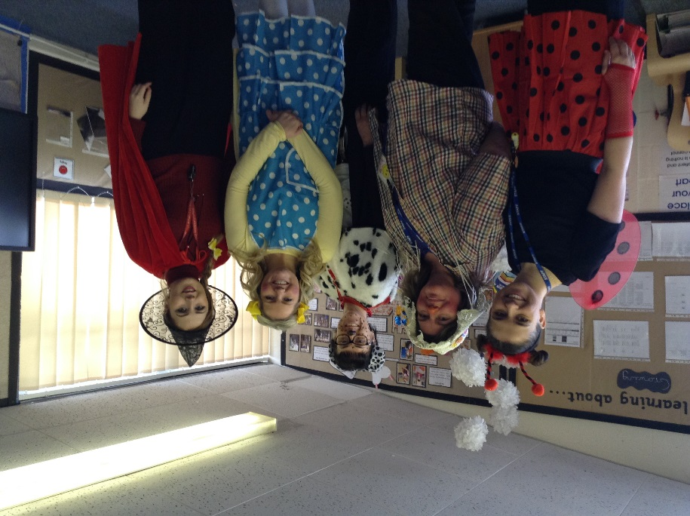
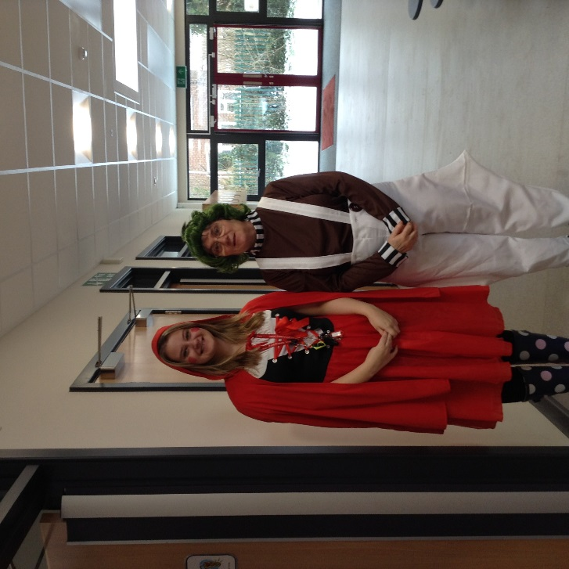
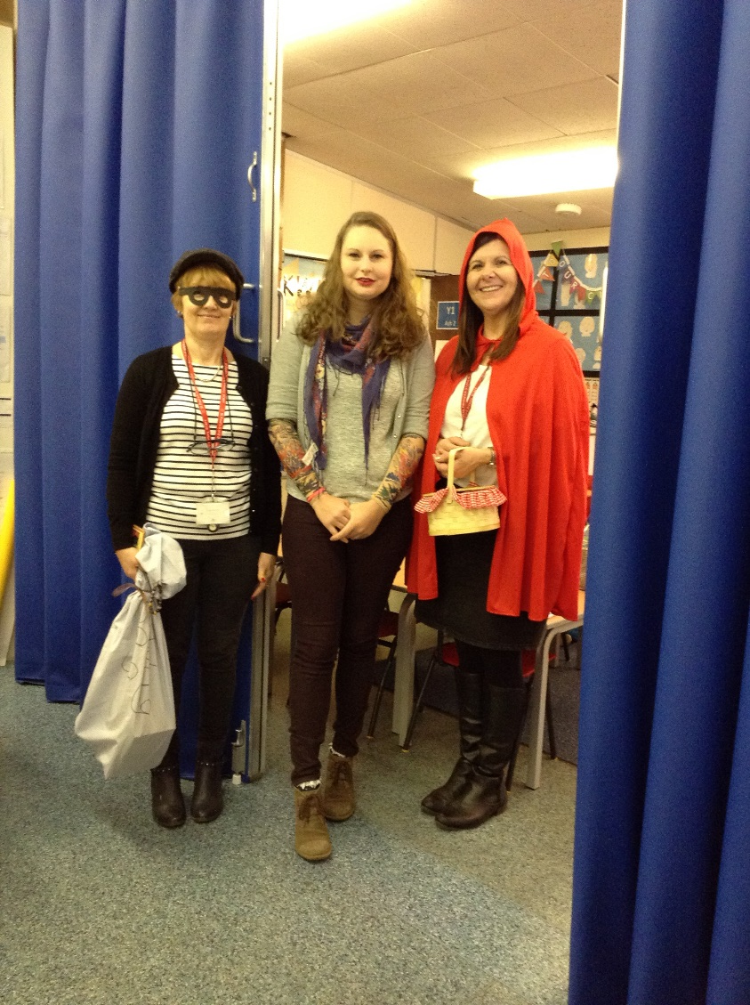
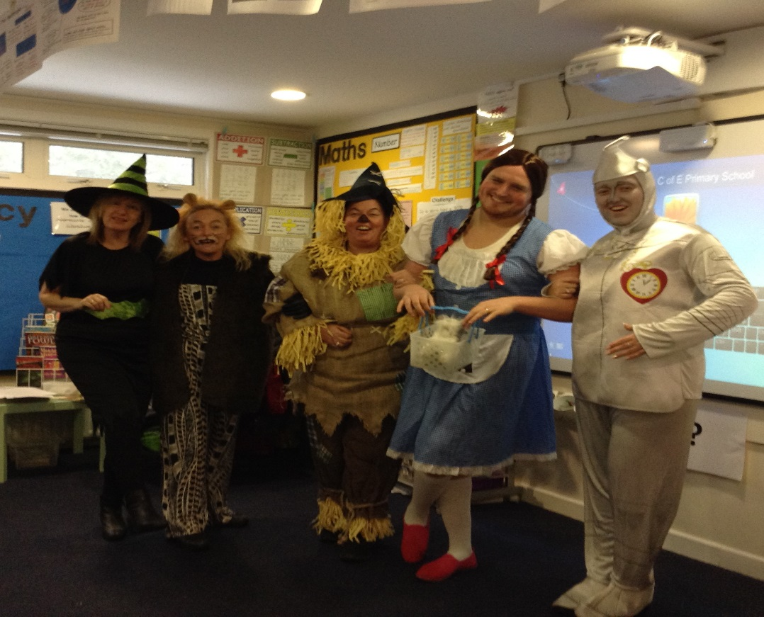
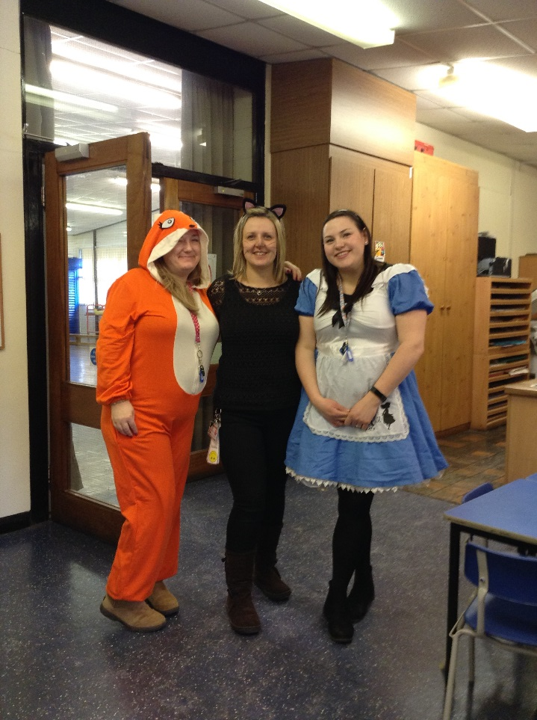
World
Book Day
Notes:
World Book day is a big event
Different each year but themed
Science fiction theme
Class book theme

Slide 28
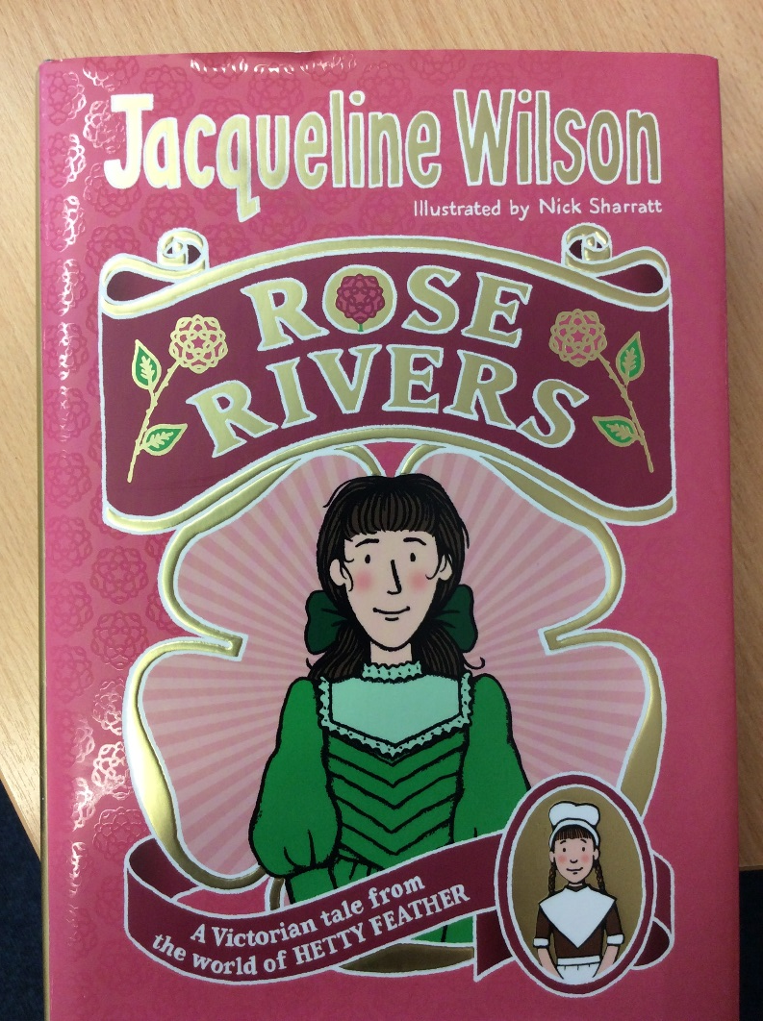
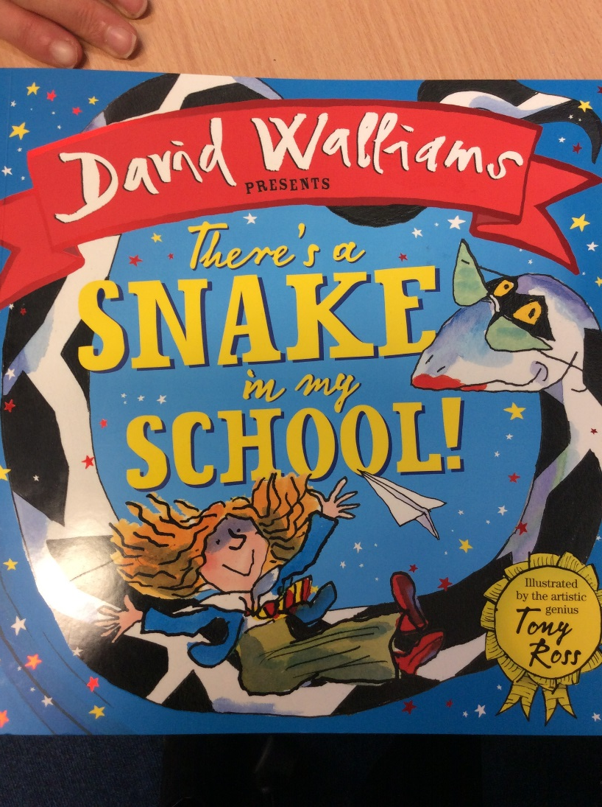
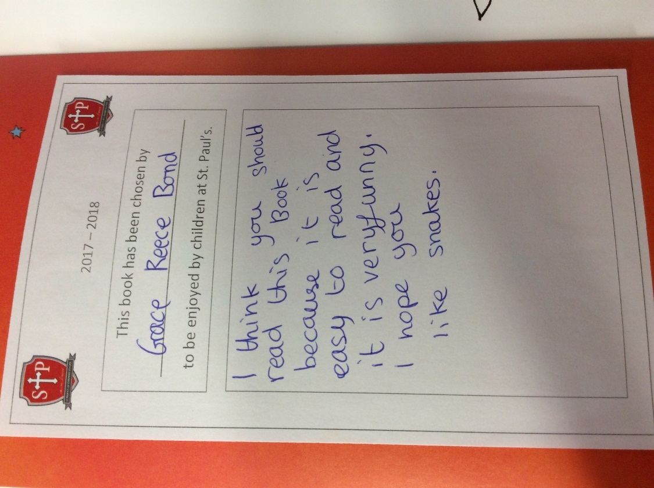
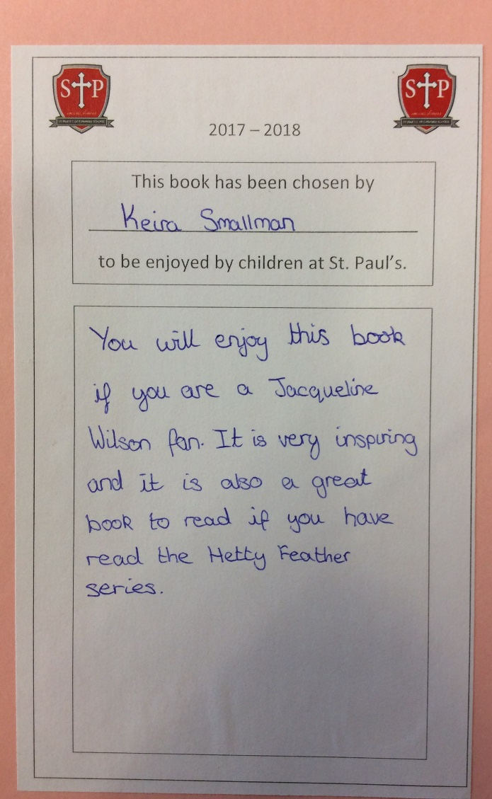
Books from Year 6
Notes:
End of the Y6 choose a book to buy for the school
Write a dedication/ review the assembly start of next year
To promote

