Slide 1
Our Spiritual Reflection Garden has had a makeover…
But what is this area for?

Slide 2
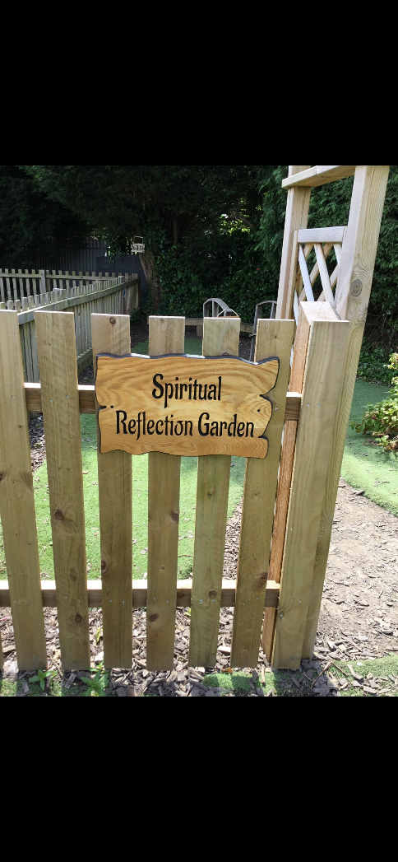
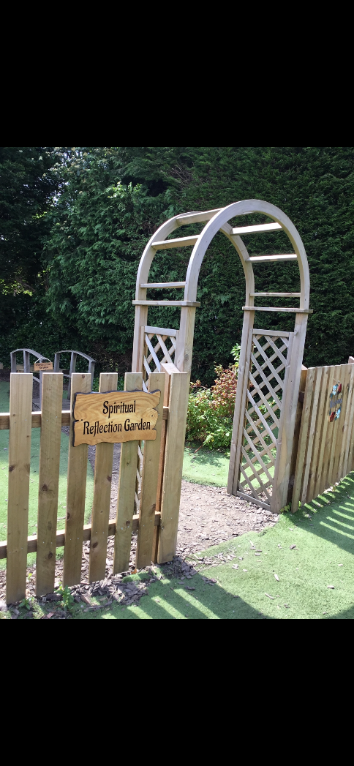
St. Paul’s Spiritual Reflection Garden

Slide 3
This area of our school is for anybody that wants to have some quiet time, time to think and maybe have some spiritual reflection.
What do we mean by spiritual?

Slide 4
Spirituality
“Spirituality is not something we can see; it is something we feel inside ourselves. It is about awe and wonder, asking questions, inspiration and being aware of something ‘bigger’ outside of ourselves.”
A sense of awe and wonder
Care for nature and living things
Wanting to love and to be loved by people

Slide 5
A sense of awe and wonder
Children are born inquisitive, and it is important to nurture this natural curiosity and guide everybody towards looking at the world and noticing, with awe and wonder, the natural and man-made delights all around us. We want to encourage you to ask ‘big questions’ about life, religion, nature, science and any other area of fascination.

Slide 6
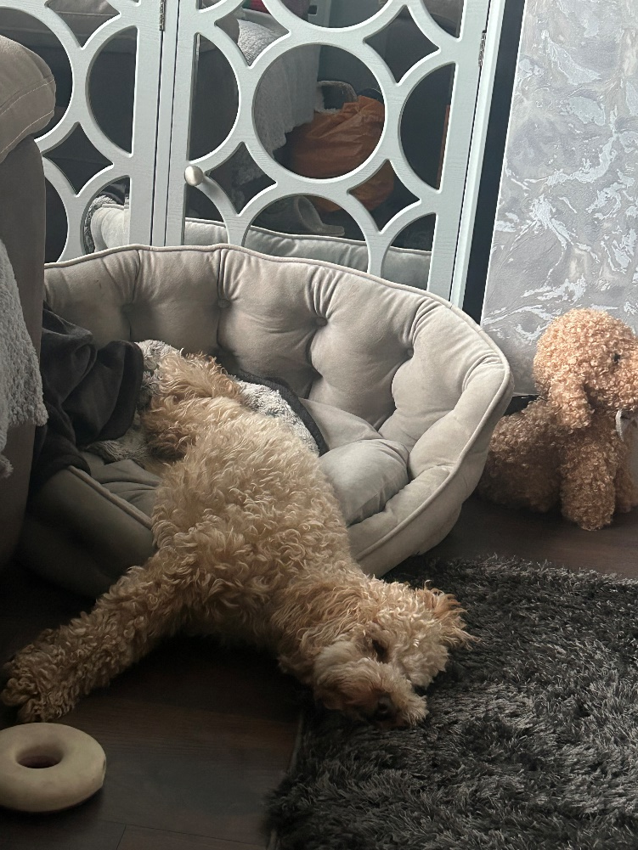
Care for nature and living things
We want to provide many opportunities for our children to learn about nature and the role they play in protecting our world. As a Church School, this is especially important. We have a very active Eco Committee and Gardening Club. We have provided bird feeders and want to increase this around school. Through science and topic work, children learn about the world and how they can care for living things. We also have our school therapy dog Miss Molly who helps us to understand how to care and love our animals.

Slide 7
Love and relationships
We are a very caring school and pride ourselves on our ethos of family. Through our Christian Values, we teach children to care for friends, family and the community. Indeed, our curriculum includes learning about those we love and who love us and the positive relationships we form.

Slide 8
So what does reflection mean?
Reflection is having quiet time with myself and others.
When might you want to have some quiet time?

Slide 9
We might want some reflection (quiet time)…
If we are sad because we have lost a member of our family
If we are sad because we have lost a family pet
If somebody or a pet we know is poorly
If we are worried about something
What else could you reflect on?

Slide 10
Sometimes we may want some quiet time to reflect and say ‘Thank You’…
Thank you for looking after my family
Thank you for making my grandma/grandad better
Thank you for bringing my dog/cat/brother/sister into my life
Thank you for letting us have Miss Molly at school
What else could you reflect and be thankful for?

Slide 11
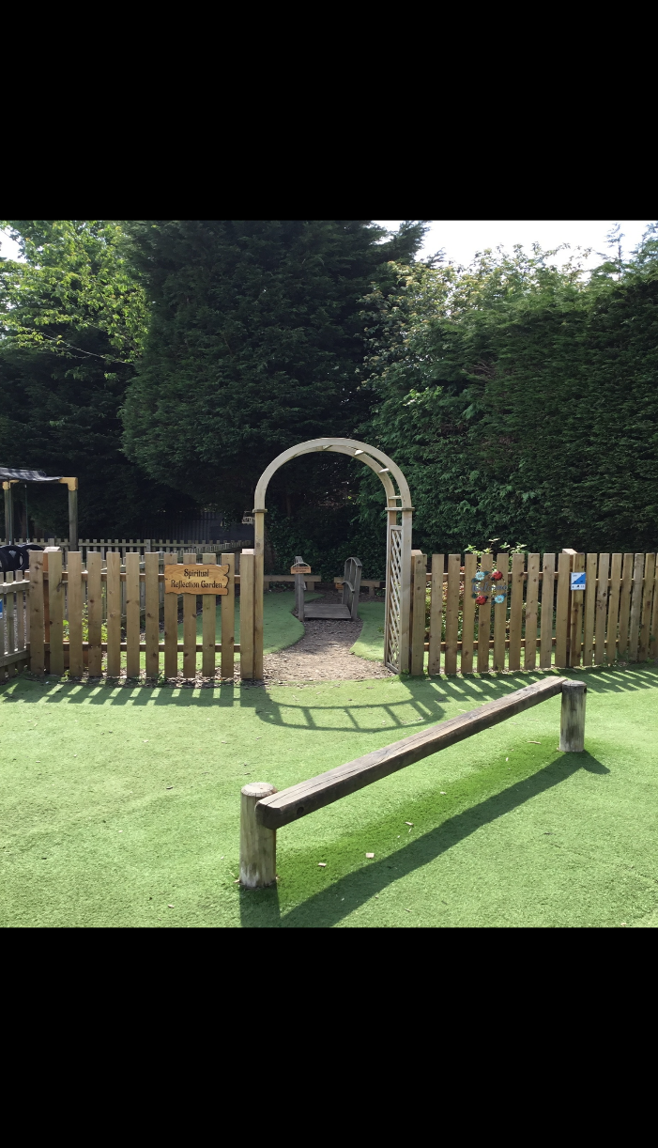
Areas of our Spiritual Reflection Garden…
Our Spiritual Reflection Garden is at the back of the trim trail. It is a quiet area for anybody who wants to think about our world, nature or spend a few moments reflecting on anything that is important to them at that moment.

Slide 12
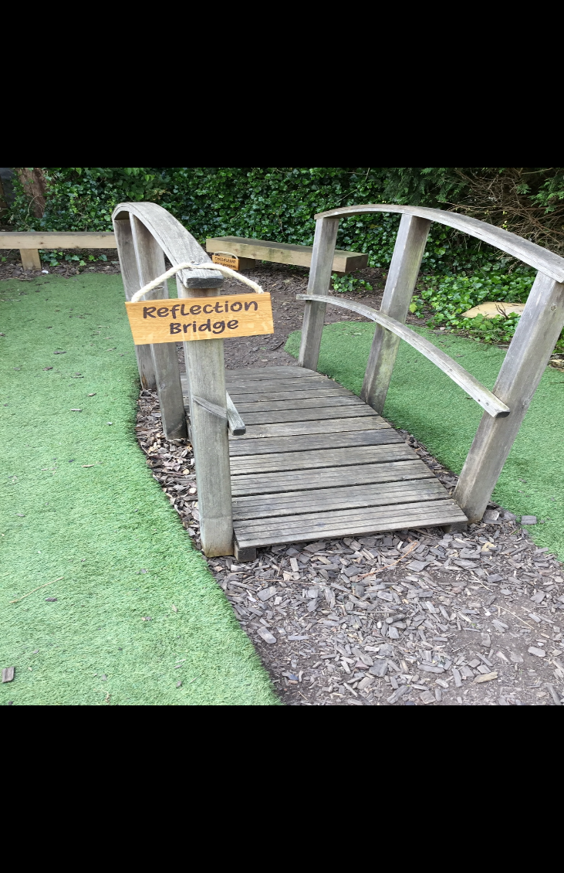
Reflection Bridge
We can stand on or cross our Reflection Bridge thinking and reflecting on the awe and wonder of our world, things that may be worrying us or saying thank you.

Slide 13
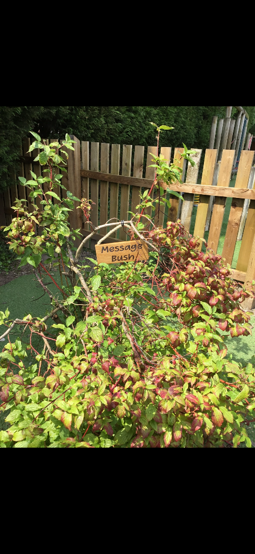
A tree/bush
There is a bush in the garden on which we can write/draw messages or thank you notes. These can be put on here with tiny pegs.

Slide 14
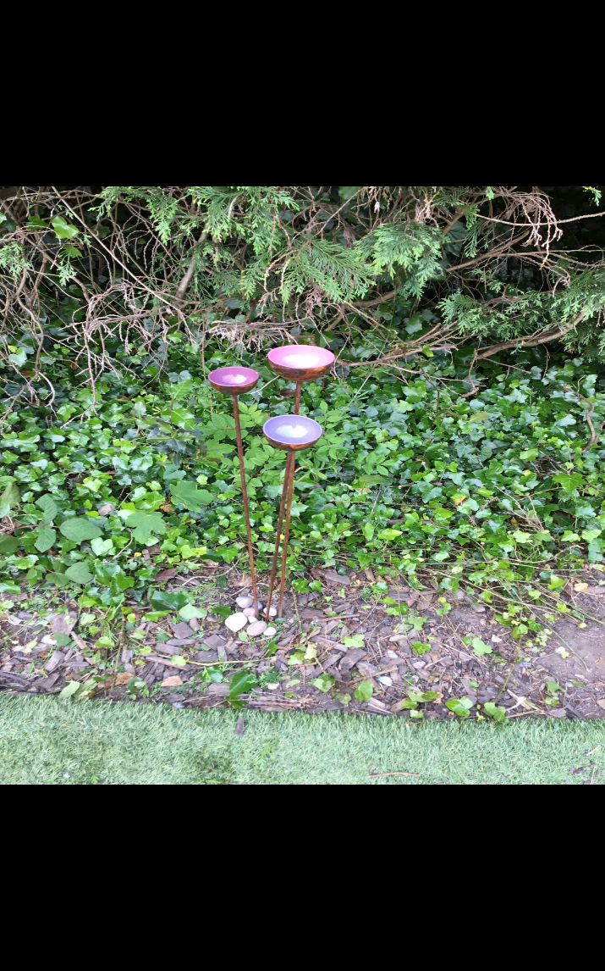
A sculpture
There is a sculpture of three bowls which will help birds and other small wild animals and insects to have access to water.
A sculpture is a piece of art work which can be nice to look at and appreciate but also sometimes it can have a function, in this case a real purpose to provide water for animals.

Slide 15
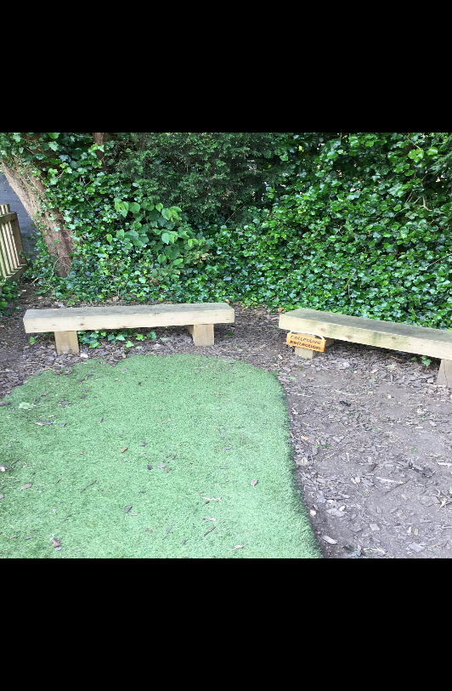
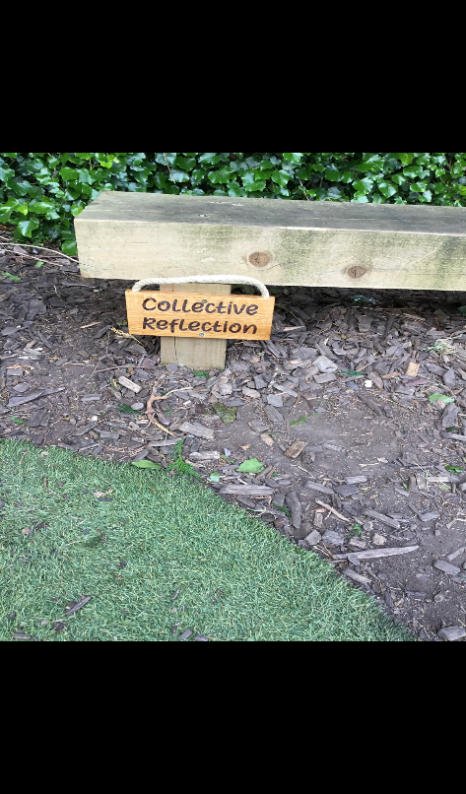
Collective Reflection Benches
Here you can sit with a friend or two and reflect together, chat about nature, wonder about amazing things in the school, exciting things they have experienced or wondrous things in the world and beyond our planet.
You can ‘just be in the moment’ embracing quiet spiritual feelings within nature.

Slide 16
Gods Animals…
There is also going to be an area dedicated to wooden statues and sculptures of lots of different animals, Gods animals!
Watch this space ☺ ☺ ☺

