Slide 1
Welcome to Year One!

Slide 2
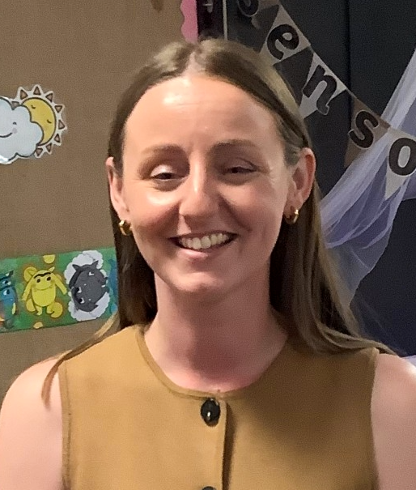
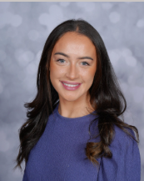
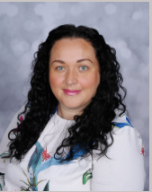
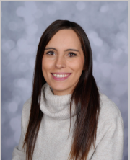
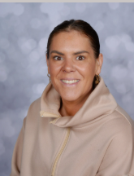
Who are the teaching staff?
The Year One teachers are Miss Healey and Miss Plunkett.
The Teaching Assistants in Y1 are Miss Hattersley and Miss Cade.
Miss Burns also cover teaching in Y1 each week.
Once a week, the children will be taught P.E.

Slide 3
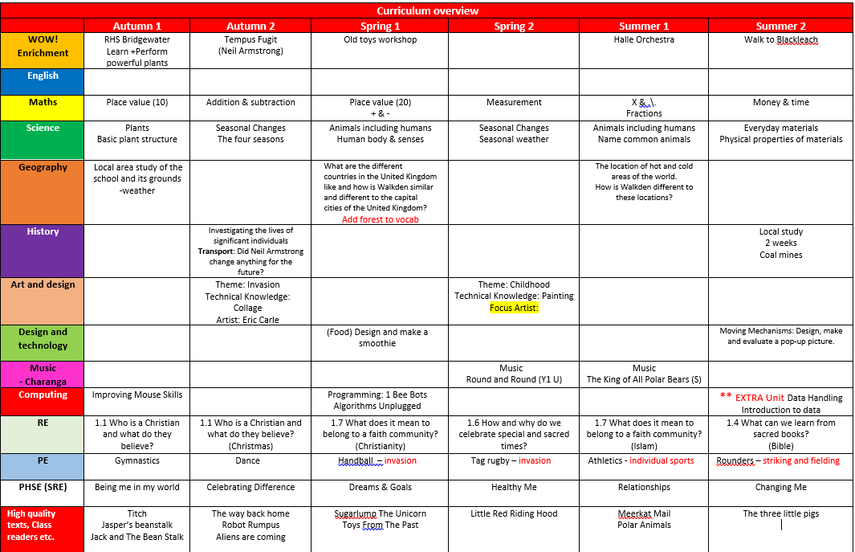
Our themes for this year.
Curriculum information is available on the school website: https://www.stpaulsce.co.uk/

Slide 4
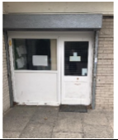
Arriving and Leaving School
Registration opens at 8.50am and closes at 9.10am.
Children in Ash class should enter and leave school through the Nursery door.
School finishes at 3.20pm and Ash class children should be collected from the Nursery door.
Any changes to home time collection arrangements must be notified by an adult to school staff and not via the child.

Slide 5
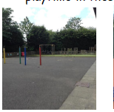
Break and Lunch Times
All children will receive toast at snack time
Milk is also available if you wish to pay for this
All children can drink from their water bottles at any time of the day (except during direct teaching!)
Children in Y1 receive a piece of fruit after lunch break
School lunches are free for children in KS1
Children may bring in packed lunches if they prefer
Children in Y1 will all have lunch and break together

Slide 6
Expectations
Children will be supported with the transition from Early Years teaching methods to a more formal learning style
Children will move to working in exercise books
Children will still have lots of practical learning opportunities
The class rooms will have a roleplay area, a reading corner plus provision areas such as a fine motor skills area
When and where possible, learning will be enhanced by visits, trips and workshops

Slide 7
P.E. kit.
Physical Education will be taught at least once a week.
The children should have the following kit: white t-shirt, black shorts and plimsolls. In addition, we would like the children to have black tracksuit bottoms in winter.
Children should bring their PE kit into school in a red drawstring bag and it will remain in school for the half term.
Earrings – children should not wear earrings for P.E. Therefore, unless they are able to remove them themselves, they should not wear them on P.E. Days.
Children with hair longer than shoulder length should tie their hair back (this applies to boys as well as girls).
A reminder - hair accessories should be small, girls socks should be white or grey and boys socks should be grey or black.

Slide 8
Reading
The children will normally have group/guided reading session 3 times each
week, with a member of the teaching staff.
Once your child has had 3 practice reading sessions of a book, they will bring the same book home on a Friday to read independently with you!
Please log any reading completed at home on the Reading With Parents platform.
If you need help accessing this online resource please ask your child’s class teacher for help.
Any reading, no matter whether it is (for example their school book or their favourite superheroes annual) should ideally be logged on the Reading with Parents platform and this reading can supplement their school reading.
It is important that the children are questioned on the book to ensure that they are understanding the text and discussing unfamiliar language. There are question prompts in the back of the book to help you.
Children will receive prizes in school for reading that is completed at home.

Slide 9
Homework
Project books will also be sent home at the start of each half term.
Some children may bring phonics packs home to practice near to the phonics screening check.
Word cards will be sent home along with the reading books.

Slide 10
Phonics Screening Check
Children in Y1 throughout the country will normally take part in a phonics screening check during the month of June. Head teachers should decide whether it is appropriate for each child to take the phonics screening check and school will discuss this with you nearer the time.
The Phonics screening check is designed to confirm whether children have learnt sufficient phonic decoding and blending skills to an appropriate standard. If your child does not reach this required standard, they will continue to be taught phonics and will have the chance to take part in the phonics screening check again at the end of Y2.

Slide 11
What Happens During The Test
The test contains 40 words
Each child will sit one to one and read each work aloud to a teacher
The test will take approximately 10 minutes per child; although all children are different and will complete the check at their own pace
The list of words the children read is combination of 20 real words and 20 pseudo words (nonsense words)

