Slide 1

Welcome to Year 6!

Slide 2
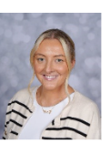
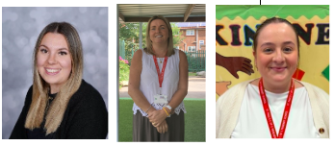
Who are the teaching staff?
Chestnut 1 = Mrs Eaton
Chestnut 2 = Mrs Kubik-Jones
The year 6 TAs are Mrs Long and Miss Boardman.
Mrs Hick and Mrs Higson will be supporting learning too.

Slide 3
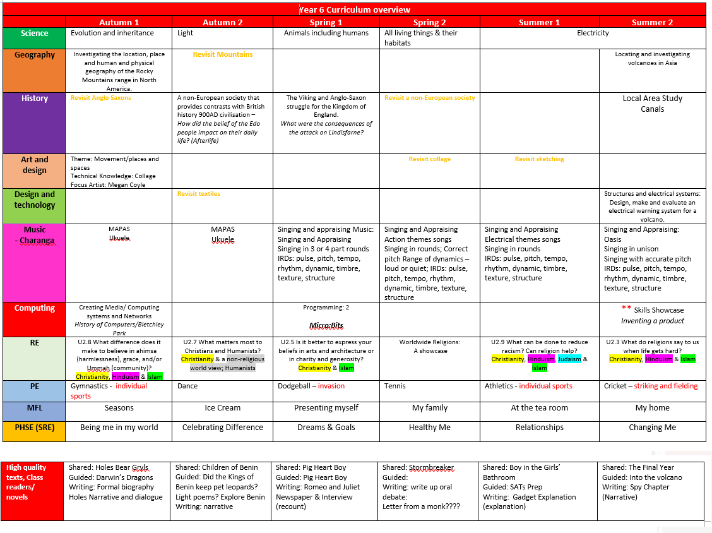
Y6 Curriculum Curriculum information is available on the school website: https://www.stpaulsce.co.uk/

Slide 4
Arriving and Leaving School
Registration opens at 8.50am and closes at 9.10am.
Children in Year 6 should walk down the path to the back of the Year 6 building.
School finishes at 3.20pm and children should be collected from the end of the Year 6 walkway.
In Year 6, children can walk home from school if parents provide permission.
Any changes to home time collection arrangements must be notified by an adult to school staff and not via the child.

Slide 5
Uniform
Y6 will wear new burgundy jumpers from September.
Due to limited storage space, only reading book bags, lunch boxes and small drawstring bags are permitted.
School will provide all stationery and a water bottle.
The children should wear a white t-shirt, black shorts/leggings/tracksuit bottoms and pumps or trainers for P.E. Children should wear their school jumpers with their P.E kit.
PE will be on a Tuesday and children should come into school wearing the correct PE kit. Earrings should be removed for PE
False nails or nail varnish should be not be worn. Only jewellery for religious/cultural reasons is allowed. Earring should be studs.

Slide 6
Reading
The children will normally have a group guided reading session each week with a member of the teaching staff.
Individual readers are heard when possible by a member of staff or school helper, but the timetable is very busy and this cannot be guaranteed everyday, so daily reading at home is essential.
Their will be rewards in class for children who read regularly at home.
Any reading, no matter whether it is their school book, or their favourite superhero annual, should ideally be logged on the “Learning with Parents” platform.

Slide 7
Homework
1 piece of Maths and 1 piece of English homework will be given out each week and is always based on current classroom learning.
Help is available any day before hand-in-day.
Any homework not completed will be done during lunchtime.
This is also given to help prepare the children for high school.
Regular reading and practising times tables would also be beneficial.

Slide 8
KS2 SATs
Monday 10th May 2027 to Thursday 13th May 2027
Grammar Test (45 mins)
Spelling Test (20 questions)
Reading Test (60 mins)
Maths Arithmetic Test (30 mins)
Maths Reasoning Test 1 (40 mins)
Maths Reasoning Test 2 (40 mins)
We will complete SATs learning checks each half-term to prepare the children for the test routines.
While practice is essential, we endeavour to make it as light-hearted and fun as possible.

Slide 9
End of Year rewards!

Slide 10
Transition to High School
You will need to apply for a high school place by 31ST October through Salford City Council School Admissions portal.
We would recommend attending high school open evenings in September and October to support you in choosing the best school for your child.
Staff can support with applications if required.
You will find out where your child has been allocated in March.
School will complete transition activities and meetings during the summer term to support your child.
School will work with High School to ensure children who need a more enhanced transition package receive additional support.

