Slide 1
Welcome to Year 3!

Slide 2
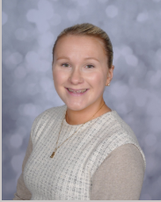
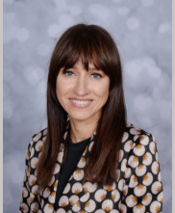
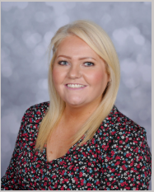
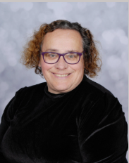
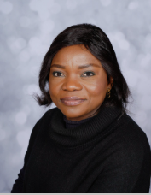
Who are the teaching staff?
The year 3 teaching staff are: Mrs Dixon and Miss Simpkin
The Teaching Assistants working with Y3 across the week are:Mrs Greaves; Mrs Hattersley and Miss Gadula.
On one afternoon each week will be taught P.E.

Slide 3
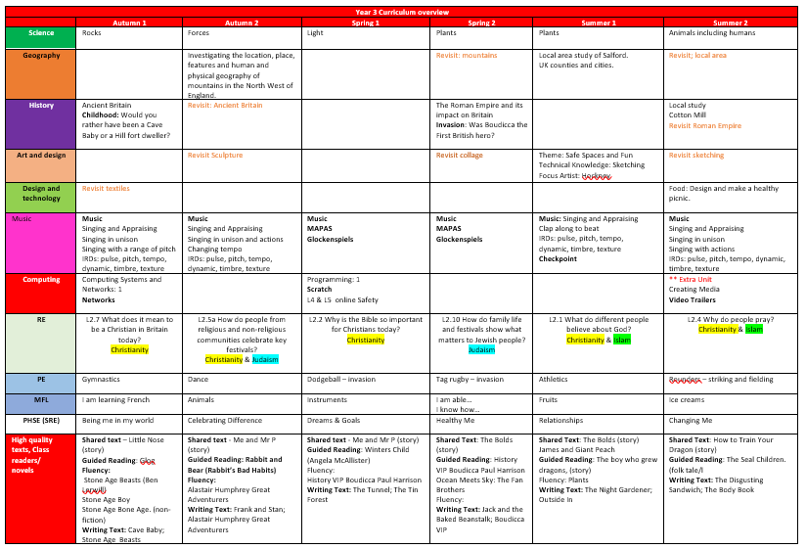
Y3 Curriculum Curriculum information is available on the school website: https://www.stpaulsce.co.uk/

Slide 4
Arriving and Leaving School
Registration opens at 8.50am and closes at 9.10am.
Children in Maple One and Maple Two should enter and leave school through designated doors which will be signposted on the playground
School finishes at 3.20pm and Maple class children should be collected from the playground
Any changes to home time collection arrangements must be notified by an adult to school staff and not via the child.
.

Slide 5
P.E. – days, kit and other uniform.
The children should have the following kit: white t-shirt, black shorts and plimsolls. In addition, we would like the children to have tracksuit bottoms in winter. Ideally these would be plain blue or black bottoms.
Children should bring their PE kit into school in a red drawstring bag and it will remain in school for the half term.
Earrings – children should not wear earrings for P.E. Therefore, unless they are able to remove them themselves, they should not wear them on P.E. Days.
Children with hair longer than shoulder length should tie their hair back (this applies to boys as well as girls)
A reminder - hair accessories should be small, girls socks should be white or grey, and boys socks should be grey or black.
Please do not bring backpacks into school as we do not have storage space. Children will all receive a bag in September to keep their kit in.

Slide 6
Reading
The children will normally have a group/ guided reading session each week with a member of the teaching staff
Individual readers are heard when possible by a member of staff or school helper but the timetable is very busy and sometimes this cannot be guaranteed, so daily reading at home is essential.
Any reading, no matter whether it is their school book, or their favourite superhero annual should ideally be logged on the Learning with Parents reading platform.
At their stage of development, it is important that the children are questioned on the book to ensure that they are understanding the text and discussing unfamiliar language.
Children receive rewards in school for reading completed at home.

Slide 7
Support.
If your child did not pass the phonics screening check in Y1 or Y2 she or he will continue to receive additional support with reading and spelling. This will not necessarily be phonic based learning as different teaching strategies may be more appropriate.
All work is adapted to meet the needs of individual children through “personalised learning”.

Slide 8
Homework and homework books.
Children may also be asked to practise times tables in preparation for the multiplication check at the end of Y4.
Children will all have a log in for Time Table Rockstars
Project books will also be sent home at the start of each half term.

